Slide 1

Flutter - Notes
Abdul Hafeez
www.codehafeez.com

Slide 2
The cross-platform development framework has the ability to write one code and can deploy on the various platform (Android, iOS, web, and Desktop).
Flutter developed from Google in 2015 year, written in Dart.
https://docs.flutter.dev/get-started/install/windows
Install (Git, Android Studio)
Download flutter file from website and unzip (flutter.zip) c driver.
Go to c drive flutter folder and run fie (flutter_console.bat)
Set environment variable
Path => C:\flutter\bin
JAVA_HOME => C:\Program Files\Java\jdk-18

Slide 4
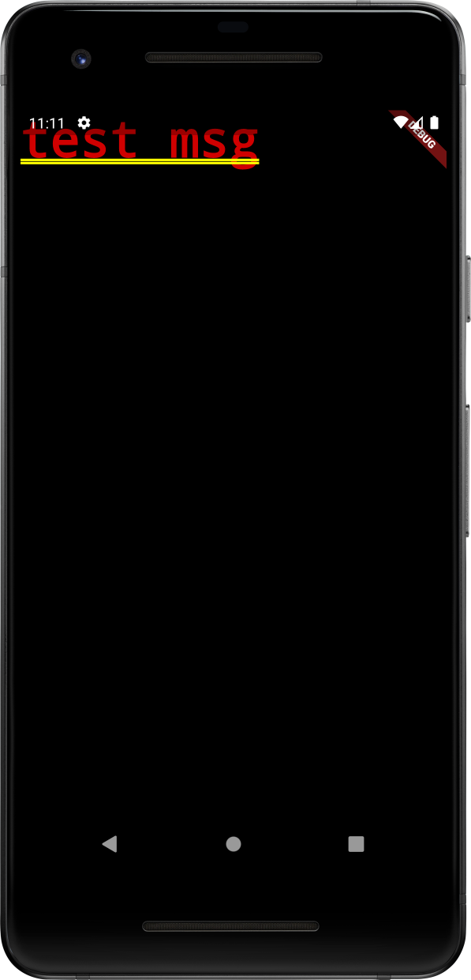
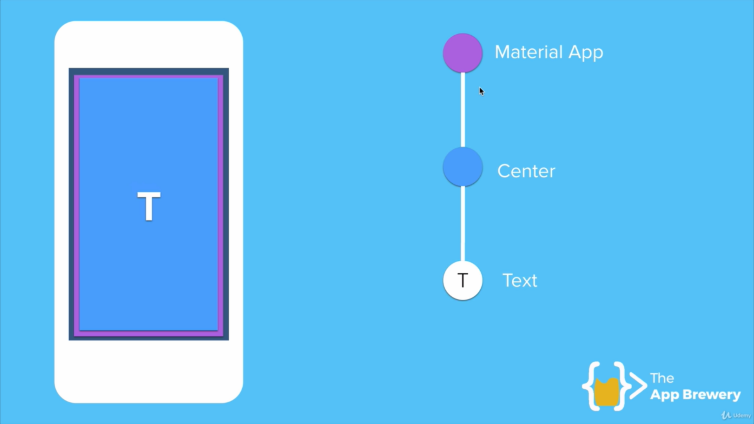
import 'package:flutter/material.dart';
void main() {
runApp(
MaterialApp(
home: Text('test msg'),
)
);
}

Slide 5
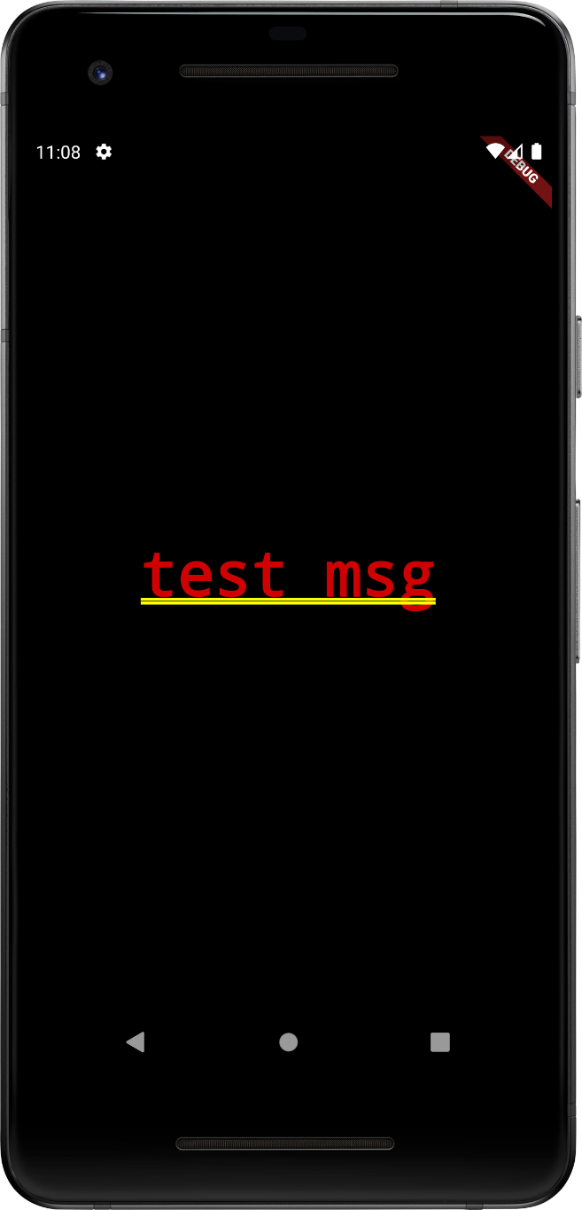
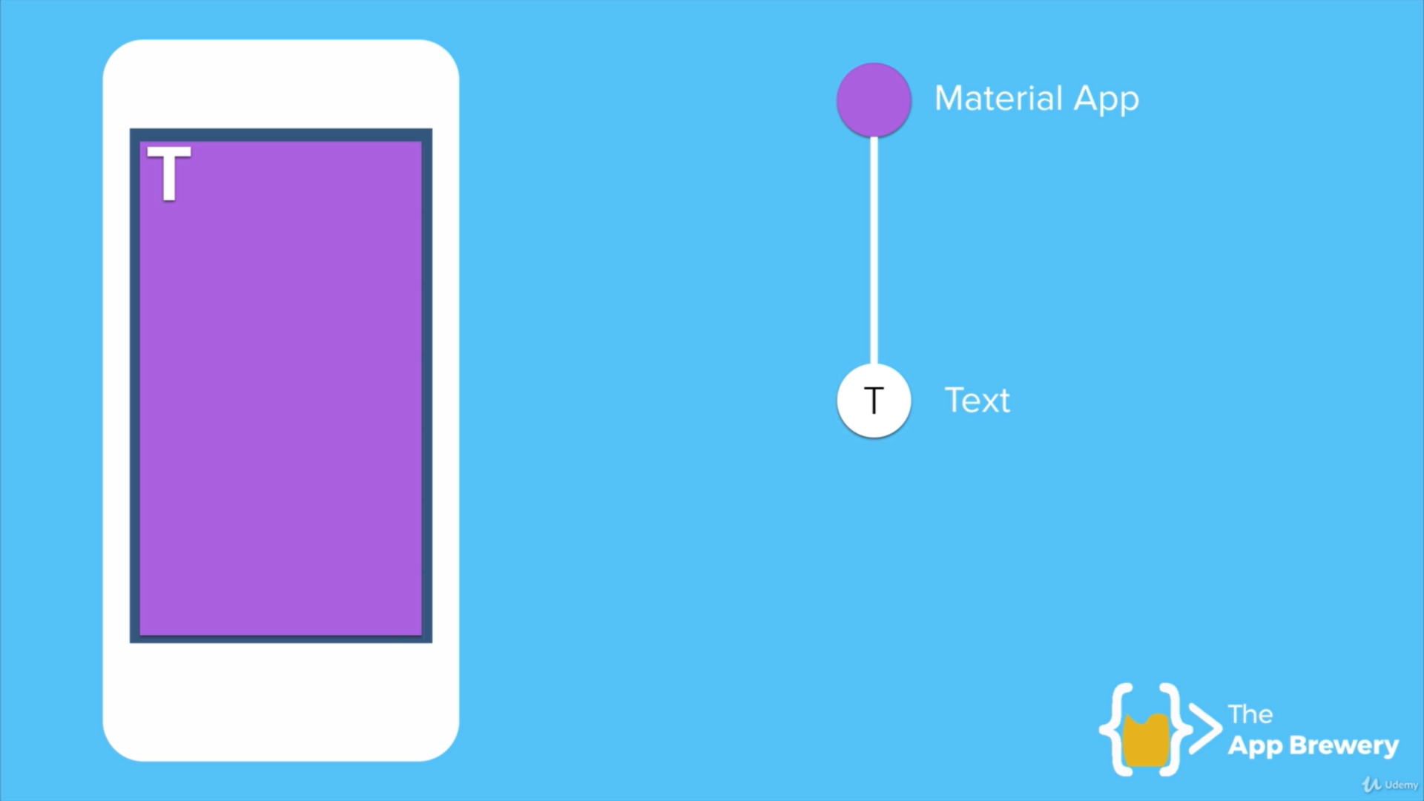
import 'package:flutter/material.dart';
void main() {
runApp(
MaterialApp(
home: Center(
child:Text('test msg'),
)
)
);
}

Slide 6
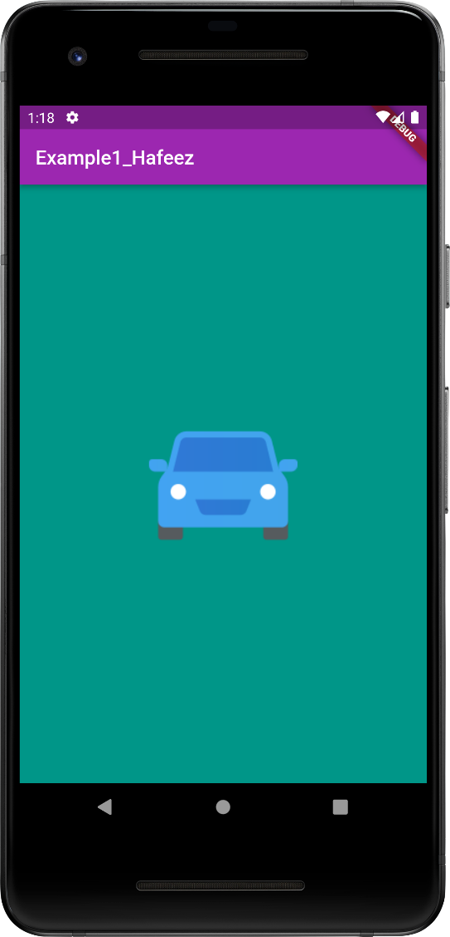
import 'package:flutter/material.dart';
void main() {
runApp(
MaterialApp(
home: Scaffold(
backgroundColor: Colors.teal,
appBar: AppBar(
title: Text('Example1_Hafeez'),
backgroundColor: Colors.purple,
),
body: Center(
child: Image(
image: NetworkImage('https://img.icons8.com/fluency/150/car.png'),
),
),
),
),
);
}
Example - 01

Slide 7
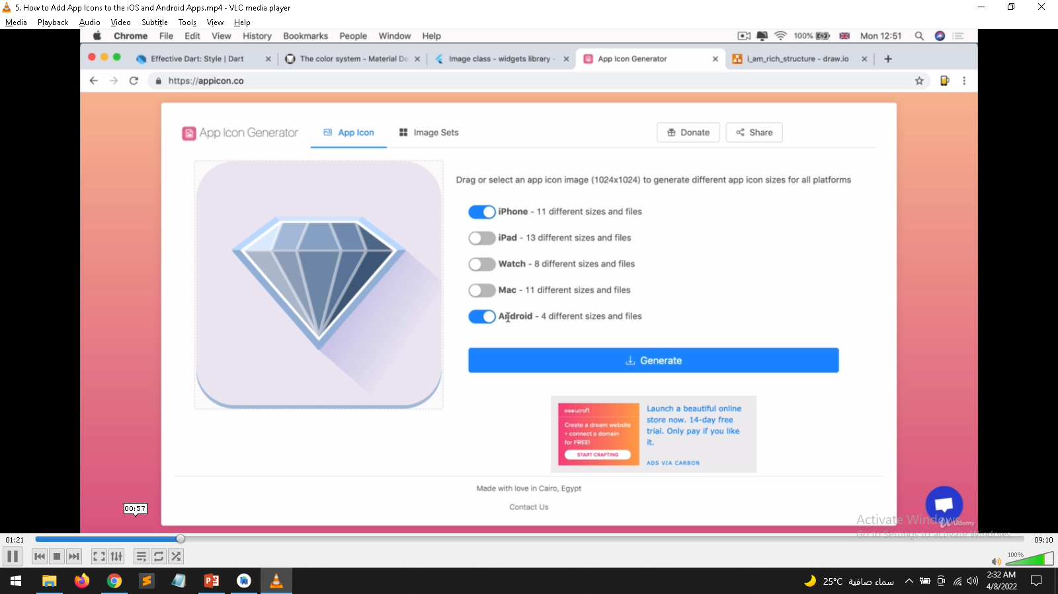
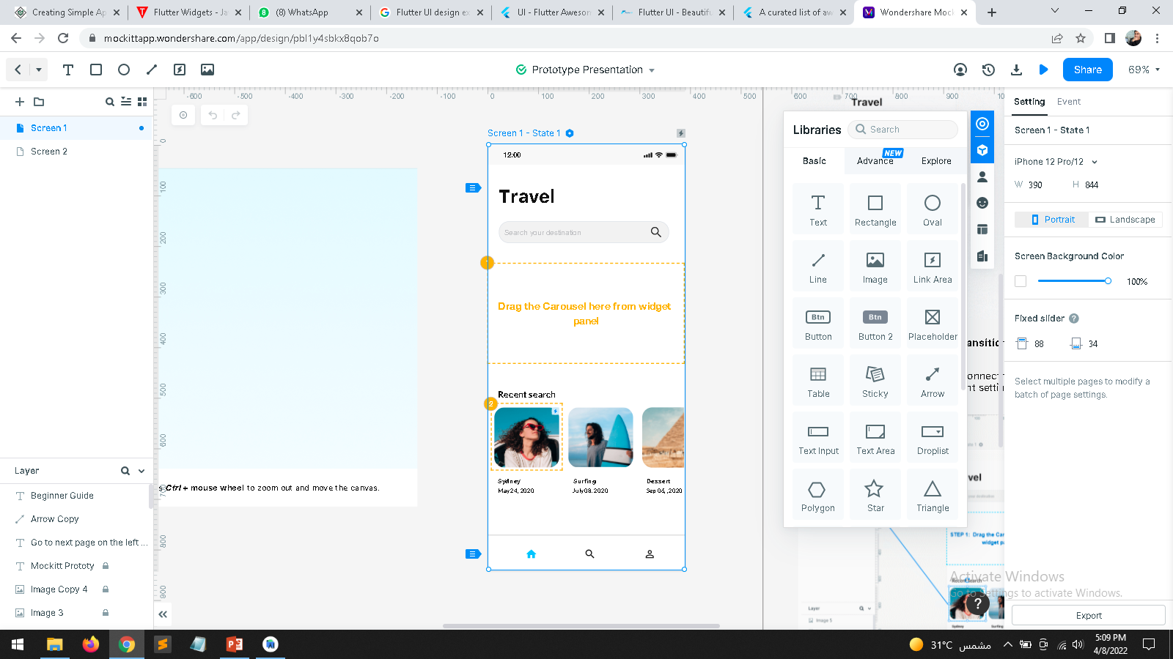
https://appicon.co/
https://fonts.google.com/
https://www.materialpalette.com/icons
https://icons8.com/
https://www.canva.com/
https://www.vecteezy.com/
https://flutterawesome.com/tag/ui/
https://flutterui.design/

Slide 8
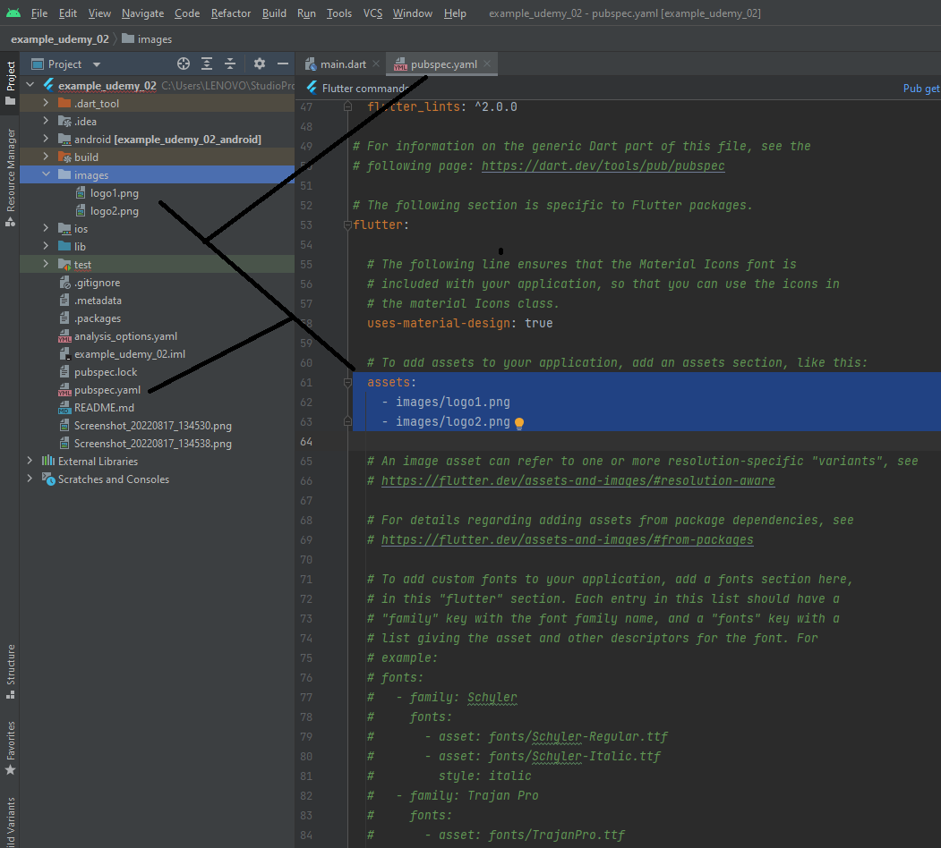
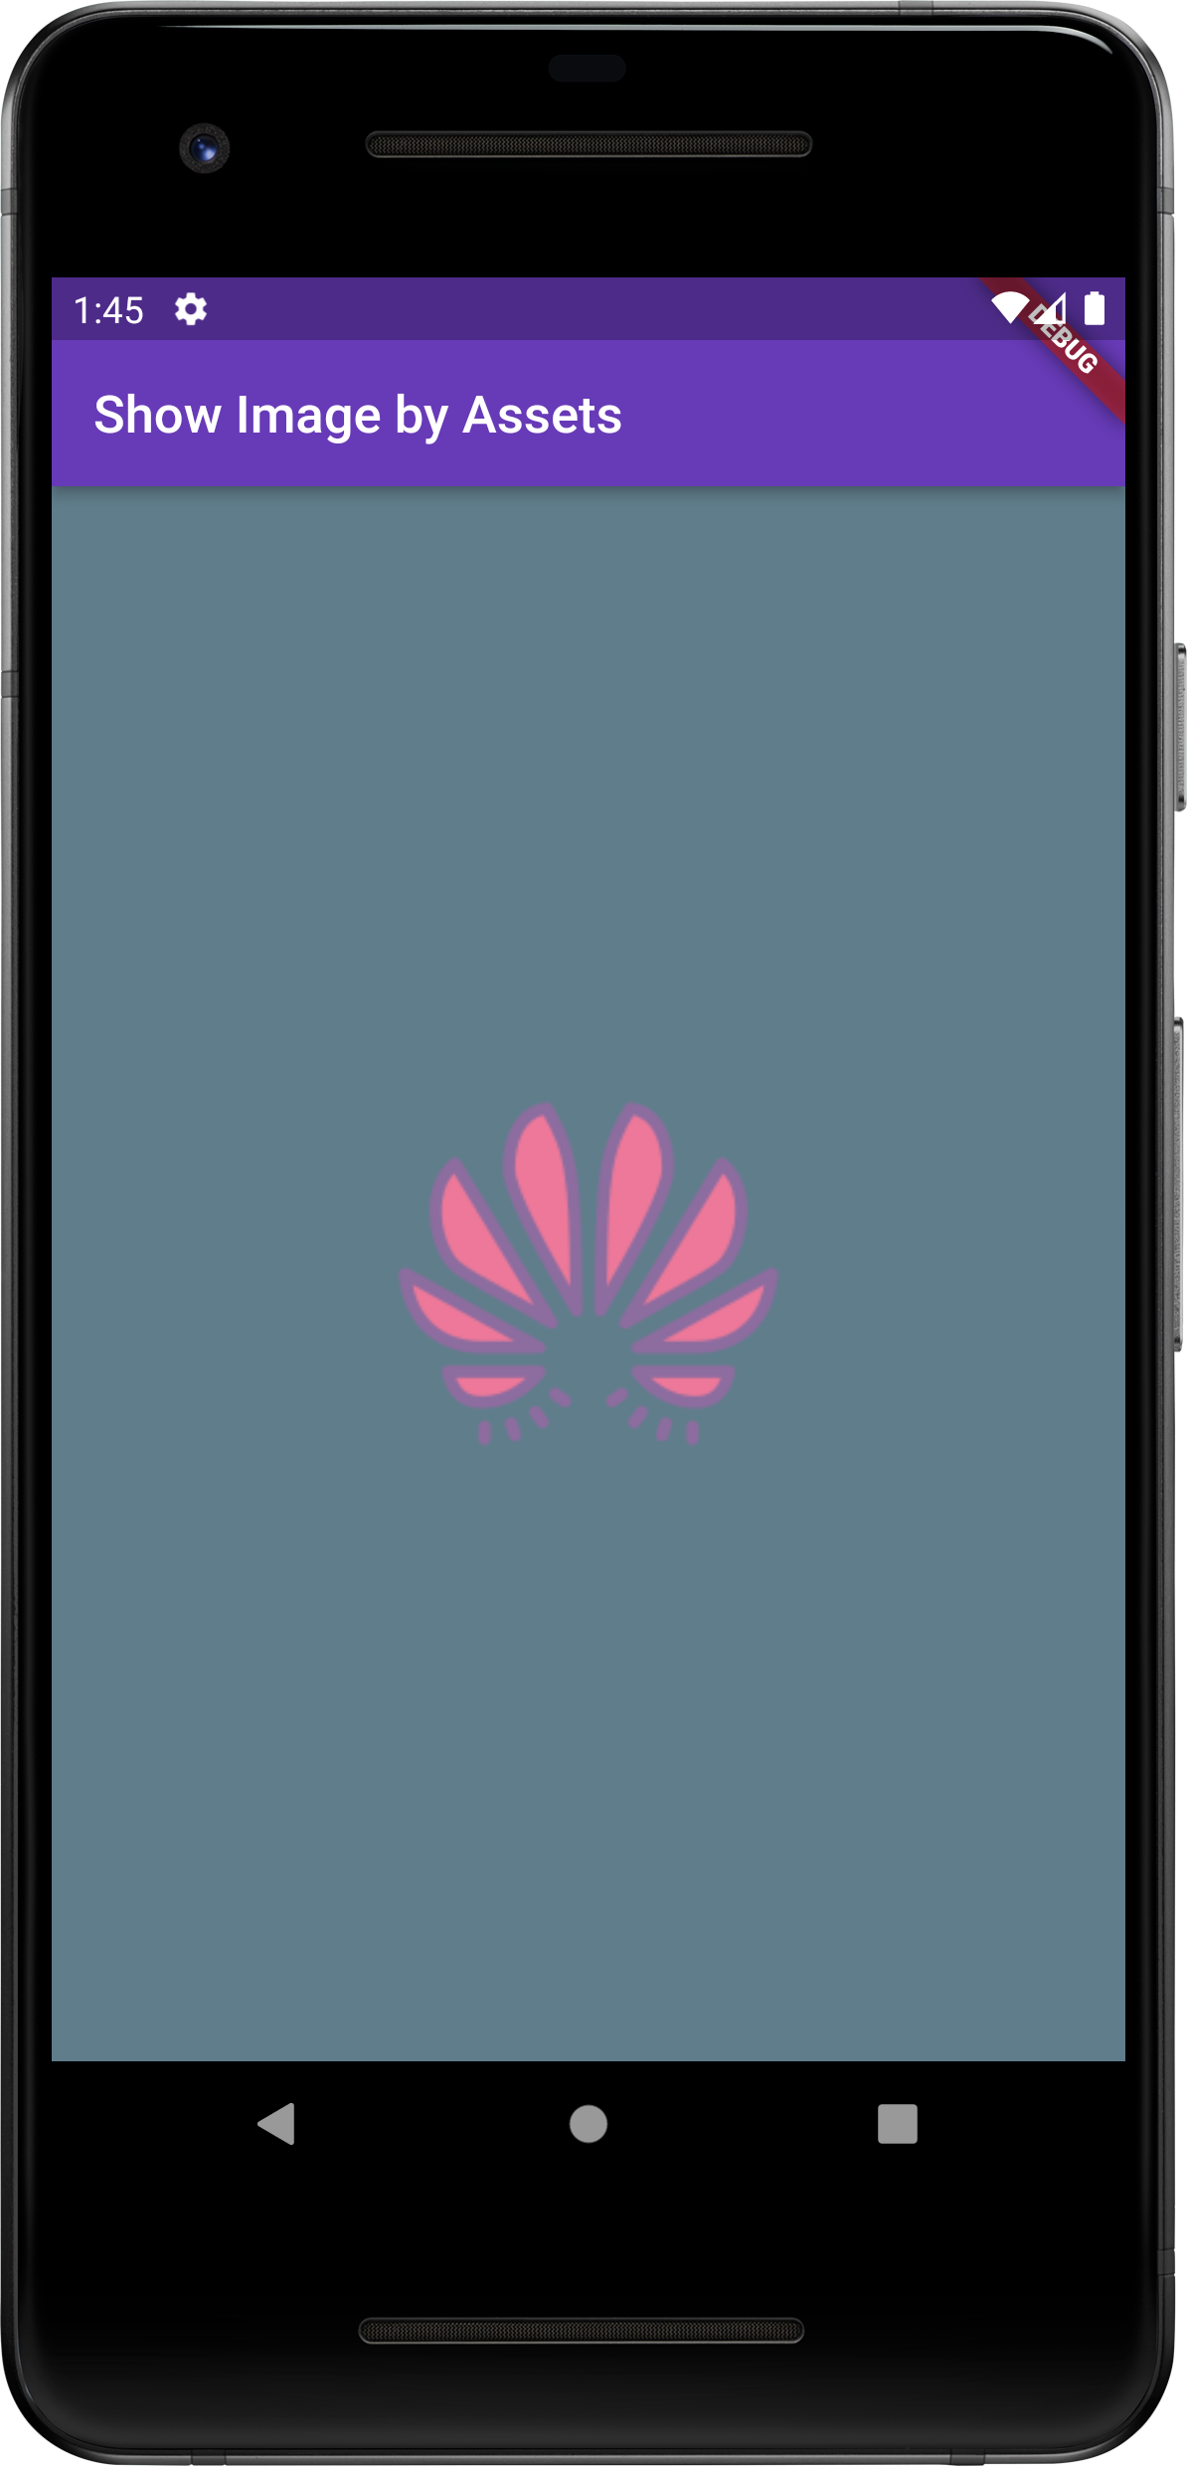
import 'package:flutter/material.dart';
void main() {
runApp(
MaterialApp(
home: Scaffold(
backgroundColor: Colors.blueGrey,
appBar: AppBar(
title: Text("Show Image by Assets"),
backgroundColor: Colors.deepPurple,
),
body: Center(
child: Image(
image: AssetImage('images/logo1.png'),
),
),
),
),
);
}
Image Configuration Settings
Example - 02

Slide 9
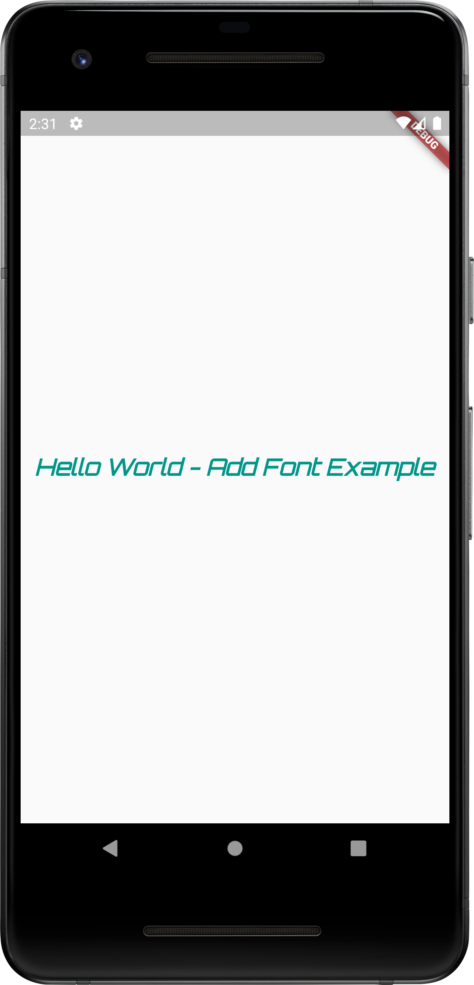
import 'package:flutter/material.dart';
void main() {
runApp(
MaterialApp(
home:Scaffold(
body: Center(
child: Text(
"Hello World - Add Font Example",
style: TextStyle(
fontFamily: 'Schyler',
fontStyle: FontStyle.italic,
fontSize: 22,
color: Colors.teal,
fontWeight: FontWeight.bold,
),
)
),
),
),
);
}
Font Style & Add Custom Fonts
Configuration Settings
Example - 03
https://fonts.google.com/

Slide 10
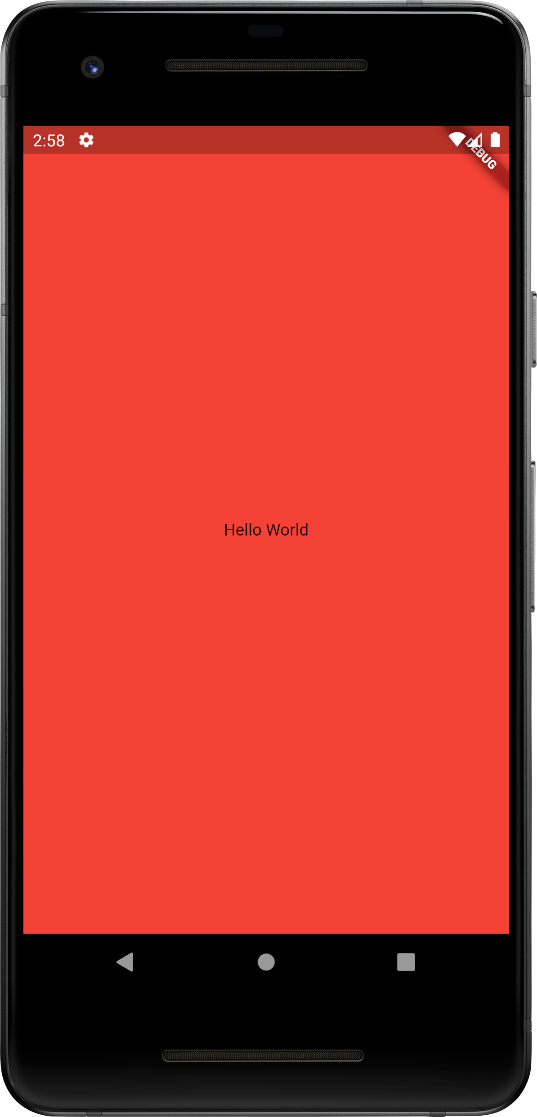
import 'package:flutter/material.dart';
void main() {
runApp(
HafeezMainApp()
);
}
class HafeezMainApp extends StatelessWidget {
const HafeezMainApp({Key? key}) : super(key: key);
@override
Widget build(BuildContext context) {
return
MaterialApp(
home: Scaffold(
backgroundColor: Colors.red,
body: Center(
child: Text("Hello World"),
),
),
);
}
}
Example - 04
State less wedge auto update/show change when we save file
Avoid hot reloading (Run again)

Slide 11
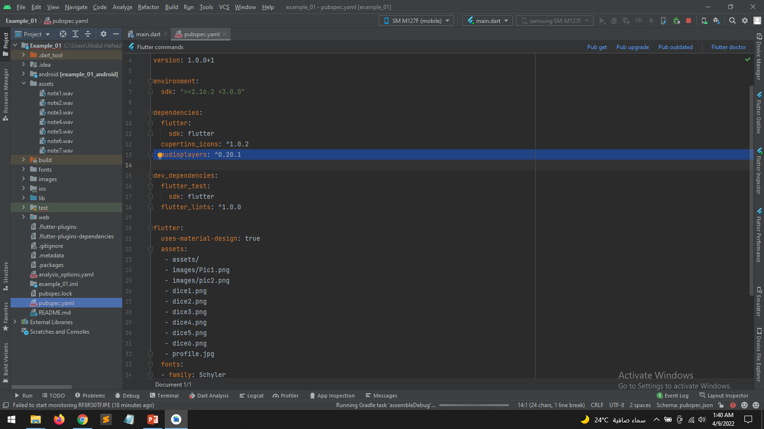
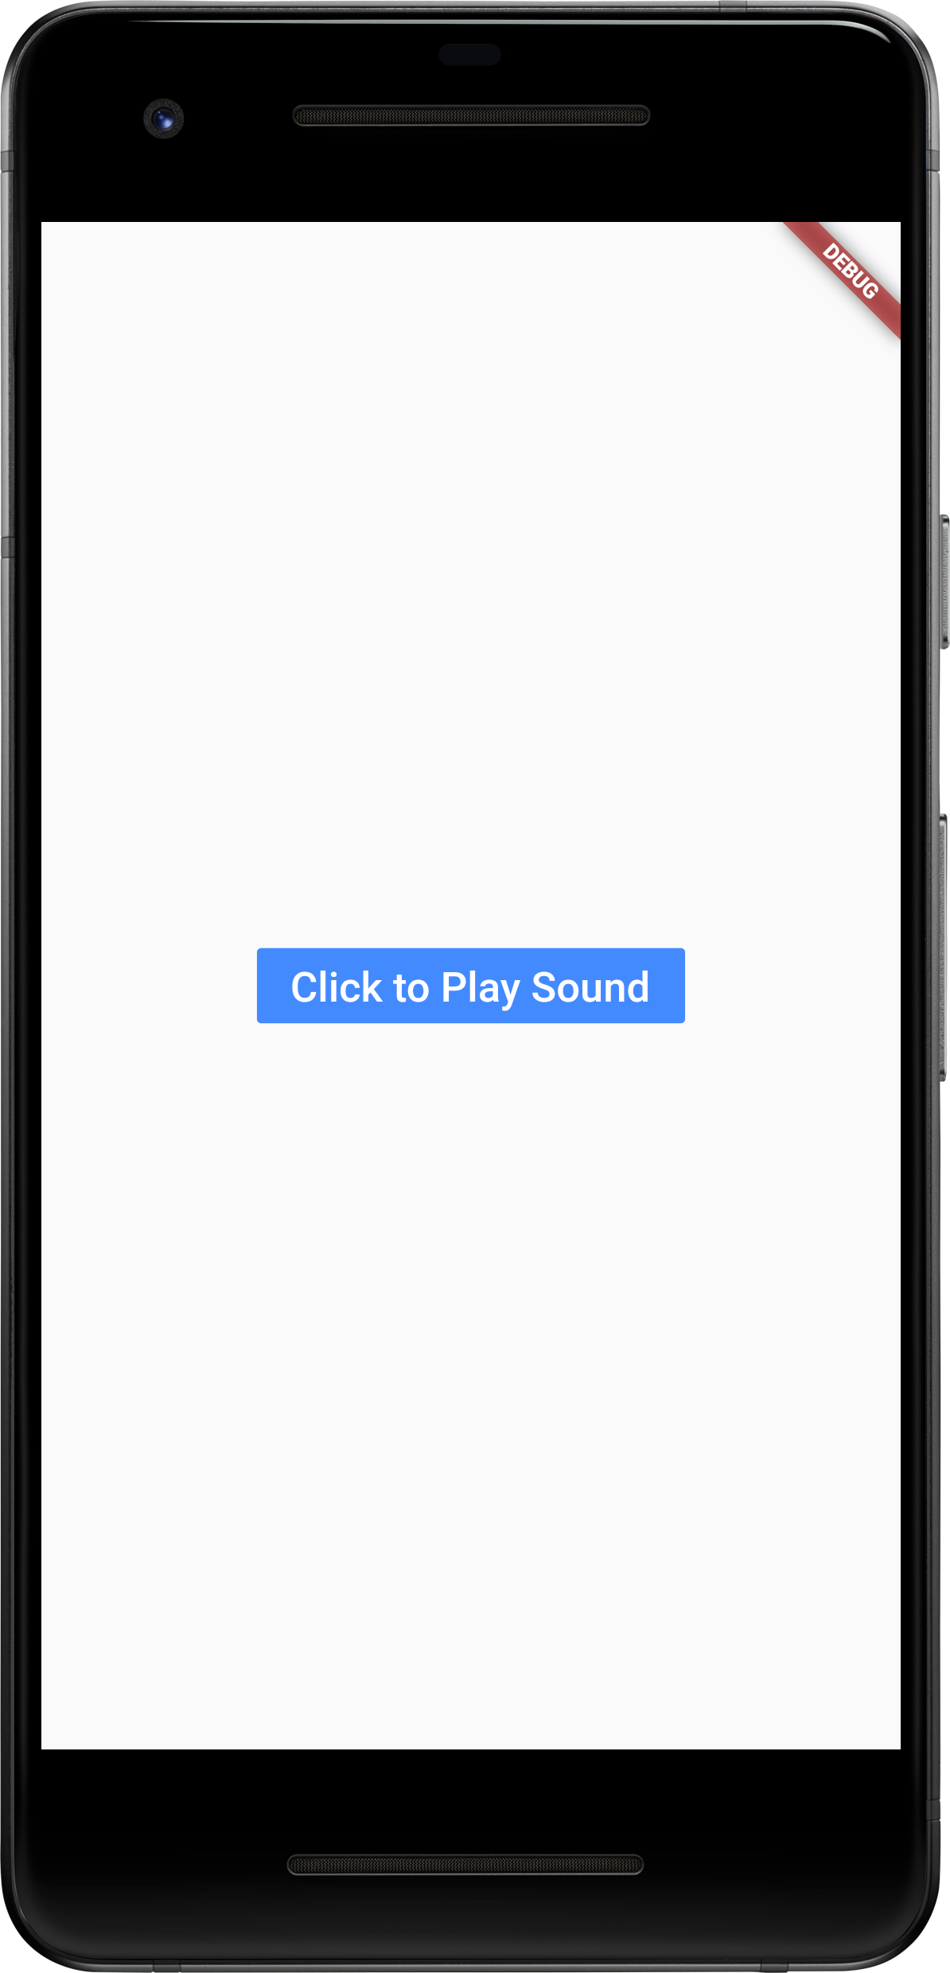
https://pub.dev/packages/audioplayers/install
import 'package:flutter/material.dart';
import 'package:audioplayers/audioplayers.dart';
void main() {
runApp(
MaterialApp(
home: Scaffold(
body: Center(
child: FlatButton(
child: Text('Click to Play Sound',
style: TextStyle(fontSize: 20)
),
color: Colors.blueAccent,
textColor: Colors.white,
onPressed: () {
playSoundFunction();
},
),
),
),
),
);
}
void playSoundFunction(){
final player = AudioCache();
player.play("sounds/note1.wav");
}
Example - 05

Slide 12
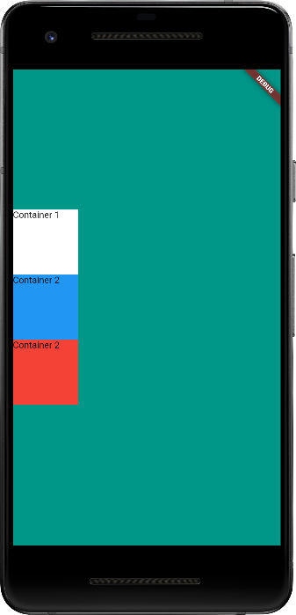
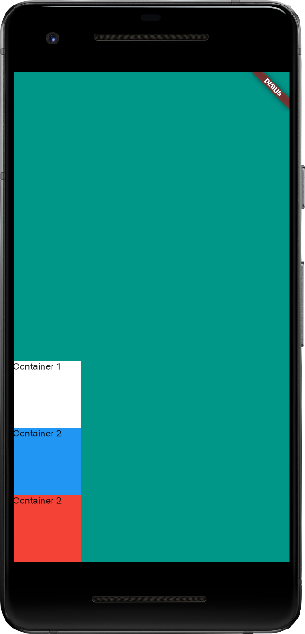
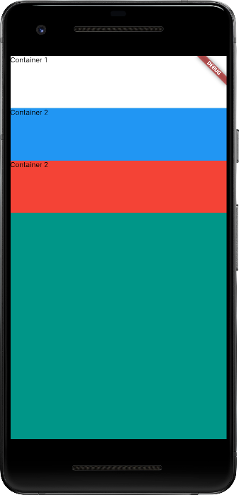
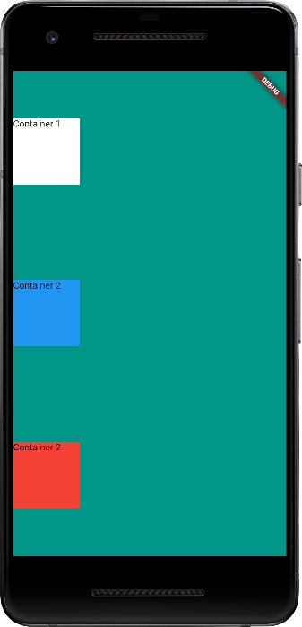
import 'package:flutter/material.dart';
void main() {
runApp(
HafeezMainApp()
);
}
class HafeezMainApp extends StatelessWidget {
const HafeezMainApp({Key? key}) : super(key: key);
@override
Widget build(BuildContext context) {
return
MaterialApp(
home: Scaffold(
backgroundColor: Colors.teal,
body: SafeArea(
child: Column(
// mainAxisAlignment: MainAxisAlignment.end,
// mainAxisAlignment: MainAxisAlignment.center,
// mainAxisAlignment: MainAxisAlignment.spaceAround,
crossAxisAlignment: CrossAxisAlignment.stretch,
children: [
Container(
width: 100,
height: 100,
color: Colors.white,
child: Text("Container 1"),
),
Container(
width: 100,
height: 100,
color: Colors.blue,
child: Text("Container 2"),
),
Container(
width: 100,
height: 100,
color: Colors.red,
child: Text("Container 2"),
),
],
),
),
)
);
}
}
UI Design – Container (Column)
Example - 06
https://docs.flutter.dev/development/ui/layout

Slide 13
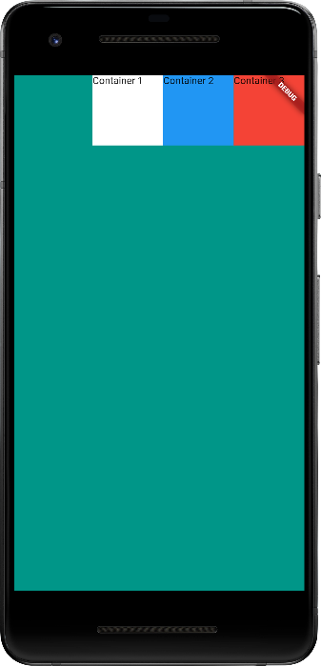
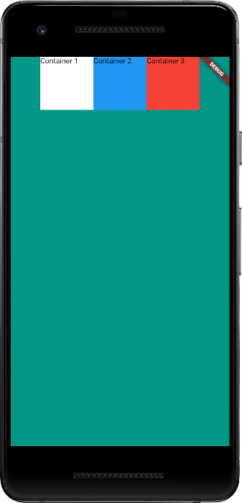
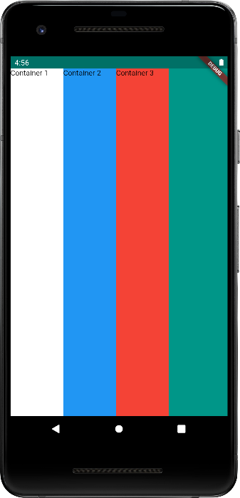
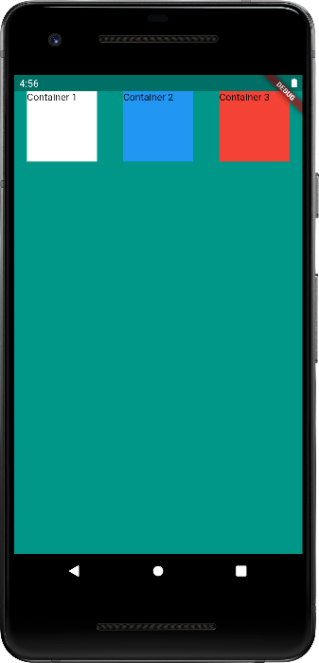
import 'package:flutter/material.dart';
void main() {
runApp(
HafeezMainApp()
);
}
class HafeezMainApp extends StatelessWidget {
const HafeezMainApp({Key? key}) : super(key: key);
@override
Widget build(BuildContext context) {
return
MaterialApp(
home: Scaffold(
backgroundColor: Colors.teal,
body: SafeArea(
child: Row(
mainAxisAlignment: MainAxisAlignment.end,
// mainAxisAlignment: MainAxisAlignment.center,
// mainAxisAlignment: MainAxisAlignment.spaceAround,
// crossAxisAlignment: CrossAxisAlignment.stretch,
children: [
Container(
width: 100,
height: 100,
color: Colors.white,
child: Text("Container 1"),
),
Container(
width: 100,
height: 100,
color: Colors.blue,
child: Text("Container 2"),
),
Container(
width: 100,
height: 100,
color: Colors.red,
child: Text("Container 3"),
),
],
),
),
)
);
}
}
UI Design – Container (Row)
Example - 07
https://docs.flutter.dev/development/ui/layout

Slide 14
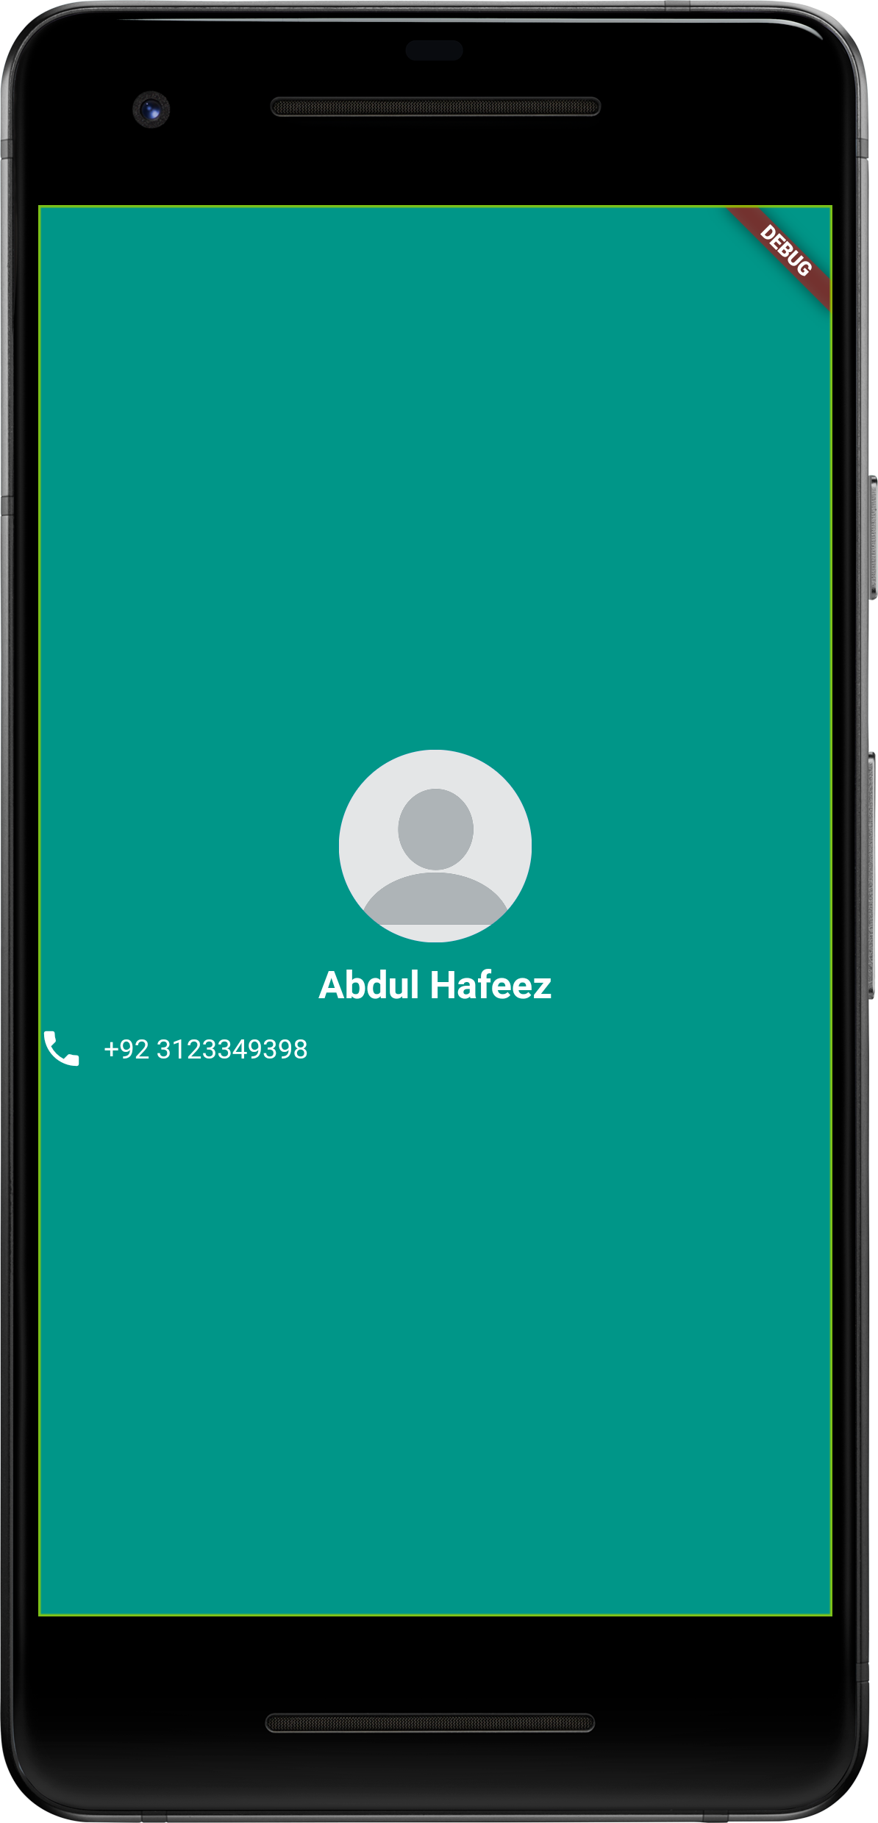
import 'package:flutter/material.dart';
void main() {
runApp(
HafeezMainApp()
);
}
class HafeezMainApp extends StatelessWidget {
const HafeezMainApp({Key? key}) : super(key: key);
@override
Widget build(BuildContext context) {
return
MaterialApp(
home: Scaffold(
backgroundColor: Colors.teal,
body: SafeArea(
child: Column(
mainAxisAlignment: MainAxisAlignment.center,
children: [
Container(
child: CircleAvatar(
radius: 50,
backgroundImage: AssetImage('images/profile.png'),
)
),
Container(
margin: EdgeInsets.symmetric(vertical: 10.0, horizontal: 5.0),
child: Text(
"Abdul Hafeez",
textAlign: TextAlign.center,
style: TextStyle(
color: Colors.white,
fontSize: 20,
fontWeight:FontWeight.bold,
),
),
),
Container(
child: Row(
children: [
Icon(
Icons.phone,
color: Colors.white,
),
SizedBox(
width:10,
),
Text(
'+92 3123349398',
style: TextStyle(
color: Colors.white,
),
),
],
),
),
],
),
),
)
);
}
}
UI Design - Container
Example - 08

Slide 15
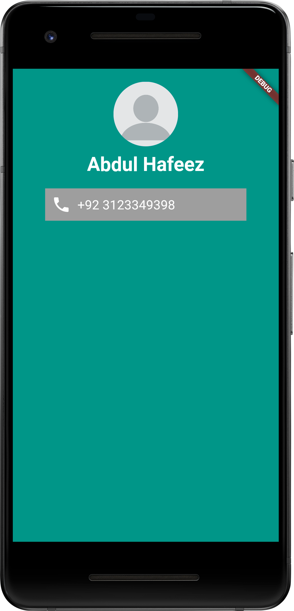
import 'package:flutter/material.dart';
void main() {
runApp(
HafeezMainApp()
);
}
class HafeezMainApp extends StatelessWidget {
const HafeezMainApp({Key? key}) : super(key: key);
@override
Widget build(BuildContext context) {
return
MaterialApp(
home: Scaffold(
backgroundColor: Colors.teal,
body: SafeArea(
child: Column(
children: [
SizedBox(height:20),
Container(
child: CircleAvatar(
radius: 50,
backgroundImage: AssetImage('images/profile.png'),
)
),
SizedBox(height:10),
Container(
child: Text(
"Abdul Hafeez",
textAlign: TextAlign.center,
style: TextStyle(
color: Colors.white,
fontSize: 30,
fontWeight:FontWeight.bold,
),
),
),
Container(
padding: EdgeInsets.all(10),
margin: EdgeInsets.symmetric(vertical:20, horizontal:50),
color: Colors.grey,
child: Row(
children: [
Icon(
Icons.phone,
color: Colors.white,
size: 30,
),
SizedBox(width:10),
Text(
'+92 3123349398',
style: TextStyle(
color: Colors.white,
fontSize: 20,
),
),
],
),
),
],
),
),
)
);
}
}
UI Design - Container
Example - 09

Slide 16
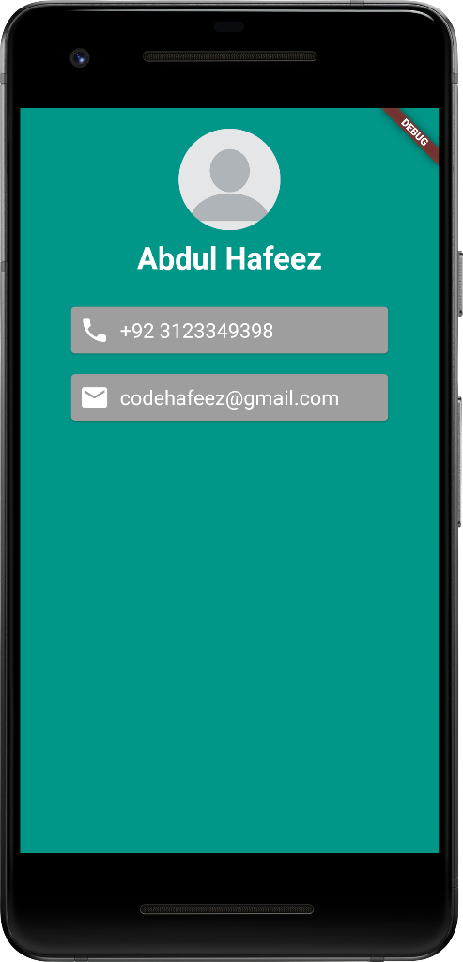
import 'package:flutter/material.dart';
void main() {
runApp(
HafeezMainApp()
);
}
class HafeezMainApp extends StatelessWidget {
const HafeezMainApp({Key? key}) : super(key: key);
@override
Widget build(BuildContext context) {
return
MaterialApp(
home: Scaffold(
backgroundColor: Colors.teal,
body: SafeArea(
child: Column(
children: [
SizedBox(height:20),
Container(
child: CircleAvatar(
radius: 50,
backgroundImage: AssetImage('images/profile.png'),
)
),
SizedBox(height:10),
Container(
child: Text(
"Abdul Hafeez",
textAlign: TextAlign.center,
style: TextStyle(
color: Colors.white,
fontSize: 30,
fontWeight:FontWeight.bold,
),
),
),
SizedBox(height:10),
Card(
margin: EdgeInsets.symmetric(vertical:20, horizontal:50),
color: Colors.grey,
child: Padding(
padding: const EdgeInsets.all(8.0),
child: Row(
children: [
Icon(
Icons.phone,
color: Colors.white,
size: 30,
),
SizedBox(width:10),
Text(
'+92 3123349398',
style: TextStyle(
color: Colors.white,
fontSize: 20,
),
),
],
),
),
),
Card(
margin: EdgeInsets.symmetric(vertical:0, horizontal:50),
color: Colors.grey,
child: Padding(
padding: const EdgeInsets.all(8.0),
child: Row(
children: [
Icon(
Icons.email,
color: Colors.white,
size: 30,
),
SizedBox(width:10),
Text(
'codehafeez@gmail.com',
style: TextStyle(
color: Colors.white,
fontSize: 20,
),
),
],
),
),
),
],
),
),
)
);
}
}
UI Design - Card
Example - 10

Slide 17
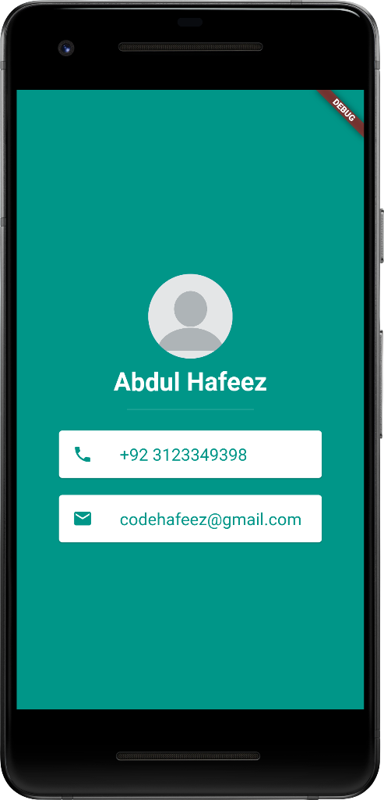
import 'package:flutter/material.dart';
void main() {
runApp(
HafeezMainApp()
);
}
class HafeezMainApp extends StatelessWidget {
const HafeezMainApp({Key? key}) : super(key: key);
@override
Widget build(BuildContext context) {
return
MaterialApp(
home: Scaffold(
backgroundColor: Colors.teal,
body: SafeArea(
child: Column(
mainAxisAlignment: MainAxisAlignment.center,
children: [
SizedBox(height:20),
Container(
child: CircleAvatar(
radius: 50,
backgroundImage: AssetImage('images/profile.png'),
)
),
SizedBox(height:10),
Container(
child: Text(
"Abdul Hafeez",
textAlign: TextAlign.center,
style: TextStyle(
color: Colors.white,
fontSize: 30,
fontWeight:FontWeight.bold,
),
),
),
SizedBox(height:10),
SizedBox(
height:10,
width: 150,
child: Divider(
color: Colors.teal.shade100,
height: 20,
),
),
Card(
margin: EdgeInsets.symmetric(horizontal:50, vertical:20),
child: ListTile(
leading: Icon(
Icons.phone,
color: Colors.teal,
),
title: Text(
'+92 3123349398',
style: TextStyle(
color: Colors.teal,
fontSize: 20
),
),
),
),
Card(
margin: EdgeInsets.symmetric(horizontal:50, vertical:0),
child: ListTile(
leading: Icon(
Icons.email,
color: Colors.teal,
),
title: Text(
'codehafeez@gmail.com',
style: TextStyle(
color: Colors.teal,
fontSize: 20
),
),
),
),
],
),
),
)
);
}
}
UI Design – Card + ListTile
Example - 11

Slide 18
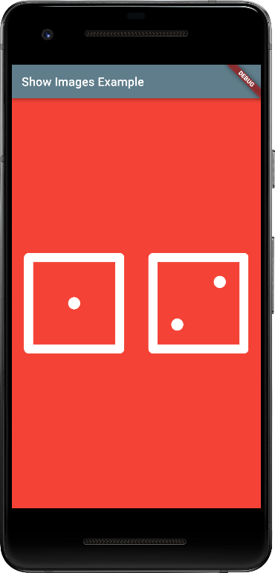
import 'package:flutter/material.dart';
void main() {
runApp(HafeezHomeApp());
}
class HafeezHomeApp extends StatelessWidget {
const HafeezHomeApp({Key? key}) : super(key: key);
@override
Widget build(BuildContext context) {
return MaterialApp(
home: Scaffold(
backgroundColor: Colors.red,
appBar: AppBar(
title: Text('Show Images Example'),
backgroundColor: Colors.blueGrey,
),
body: SafeArea(
child: Center(
child: Row(
children: [
Expanded(
child: Padding(
padding: const EdgeInsets.all(20),
child: Image.asset('images/dice1.png'),
),
),
Expanded(
child: Padding(
padding: const EdgeInsets.all(20),
child: Image.asset('images/dice2.png'),
),
),
],
),
),
),
)
);
}
}
UI Design – Expanded Image
Example - 12

Slide 19
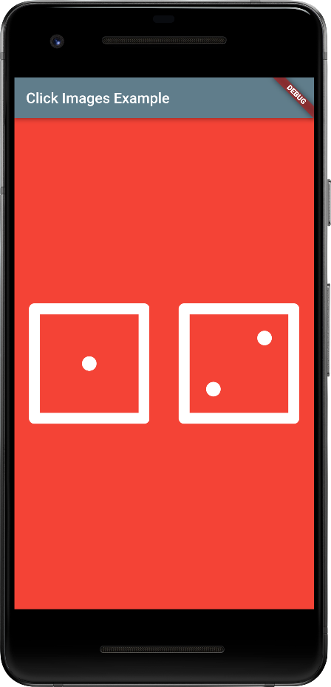
import 'package:flutter/material.dart';
import 'dart:math';
void main() {
runApp(HafeezHomeApp());
}
class HafeezHomeApp extends StatelessWidget {
const HafeezHomeApp({Key? key}) : super(key: key);
@override
Widget build(BuildContext context) {
return MaterialApp(
home: Scaffold(
backgroundColor: Colors.red,
appBar: AppBar(
title: Text('Click Images Example'),
backgroundColor: Colors.blueGrey,
),
body: SafeArea(
child: Center(
child: Row(
children: [
Expanded(
child: FlatButton(
padding: const EdgeInsets.all(20),
onPressed: () {
var currentNum = Random().nextInt(6) + 1; // 1 to 6
print('Random Number (1 to 6) : $currentNum');
},
child: Image.asset('images/dice1.png'),
),
),
Expanded(
child: FlatButton(
padding: const EdgeInsets.all(20),
onPressed: () {
print('test msg2');
},
child: Image.asset('images/dice2.png'),
),
),
],
),
),
),
)
);
}
}
Example - 13
UI Design – Expanded Image Click (Show Random Number Value Print Msg on Console)

Slide 20
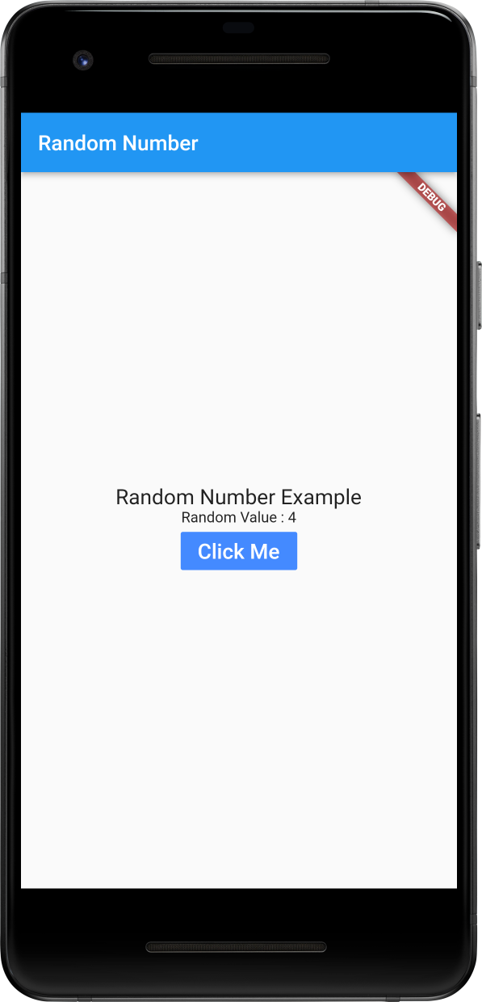
import 'package:flutter/material.dart';
import 'dart:math';
void main() {
return runApp(HomePage());
}
class HomePage extends StatefulWidget {
@override
HomePageState createState() => HomePageState();
}
class HomePageState extends State<HomePage> {
int myNumber = 0;
void changeNumberFunction() {
setState(() {
myNumber = Random().nextInt(6) + 1; // 0 to 6
});
}
@override
Widget build(BuildContext context) {
return MaterialApp(
home: Scaffold(
body: Center(
child: Column(
mainAxisAlignment: MainAxisAlignment.center,
children: <Widget>[
Text(
'Random Number Example',
style: TextStyle(fontSize: 20),
),
Text('Random Value : $myNumber'),
FlatButton(
child: Text('Click Me',
style: TextStyle(fontSize: 20),
),
color: Colors.blueAccent,
textColor: Colors.white,
onPressed: () { changeNumberFunction(); },
),
],
)),
),
);
}
}
Example - 21
Show Random Number using Function (State Full Widget)

Slide 21
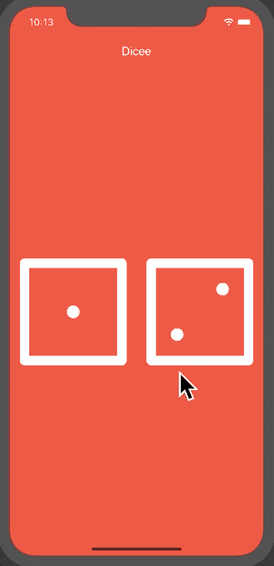
import 'dart:math';
import 'package:flutter/material.dart';
void main() {
return runApp(
MaterialApp(
debugShowCheckedModeBanner: false,
home: Scaffold(
backgroundColor: Colors.red,
appBar: AppBar(
title: Text('Dicee'),
backgroundColor: Colors.red,
),
body: HafeezMainHomeApp(),
),
),
);
}
class HafeezMainHomeApp extends StatefulWidget {
@override
HafeezPageBody createState() => HafeezPageBody();
}
class HafeezPageBody extends State<HafeezMainHomeApp> {
int leftDiceNumber = 1;
int rightDiceNumber = 1;
void changeDiceFace() {
setState(() {
leftDiceNumber = Random().nextInt(6) + 1;
rightDiceNumber = Random().nextInt(6) + 1;
});
}
@override
Widget build(BuildContext context) {
return Center(
child: Row(
children: <Widget>[
Expanded(
child: FlatButton(
child: Image.asset(
'images/dice$leftDiceNumber.png',
),
onPressed: () {
changeDiceFace();
},
),
),
Expanded(
child: FlatButton(
child: Image.asset(
'images/dice$rightDiceNumber.png',
),
onPressed: () {
changeDiceFace();
},
),
),
],
),
);
}
}
Example - 14
UI Design – Expanded Image Click to Change Image using Random Number

Slide 22
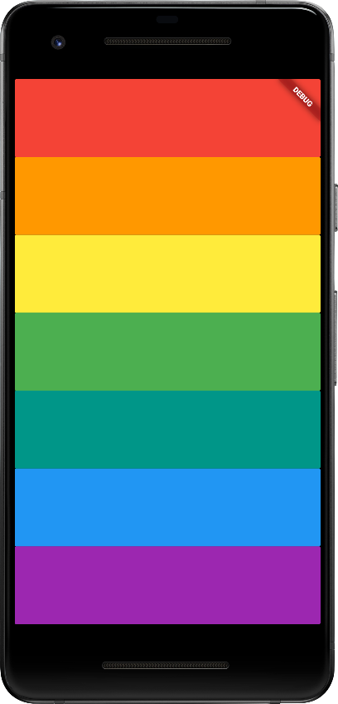
import 'package:flutter/material.dart';
import 'package:audioplayers/audioplayers.dart';
void main() => runApp(XylophoneApp());
class XylophoneApp extends StatelessWidget {
void playSound(int soundNumber) {
final player = AudioCache();
player.play('sounds/note$soundNumber.wav');
}
Expanded buildKey({Color? color, int? soundNumber}) {
return Expanded(
child: FlatButton(
child: Text(''),
color: color,
onPressed: () {
playSound(soundNumber!);
},
),
);
}
@override
Widget build(BuildContext context) {
return MaterialApp(
home: Scaffold(
backgroundColor: Colors.black,
body: SafeArea(
child: Column(
crossAxisAlignment: CrossAxisAlignment.stretch,
children: <Widget>[
buildKey(color: Colors.red, soundNumber: 1),
buildKey(color: Colors.orange, soundNumber: 2),
buildKey(color: Colors.yellow, soundNumber: 3),
buildKey(color: Colors.green, soundNumber: 4),
buildKey(color: Colors.teal, soundNumber: 5),
buildKey(color: Colors.blue, soundNumber: 6),
buildKey(color: Colors.purple, soundNumber: 7),
],
),
),
),
);
}
}
Play Sound
Click color box
Function pass by value
Example - 15
https://pub.dev/packages/audioplayers/install

Slide 23
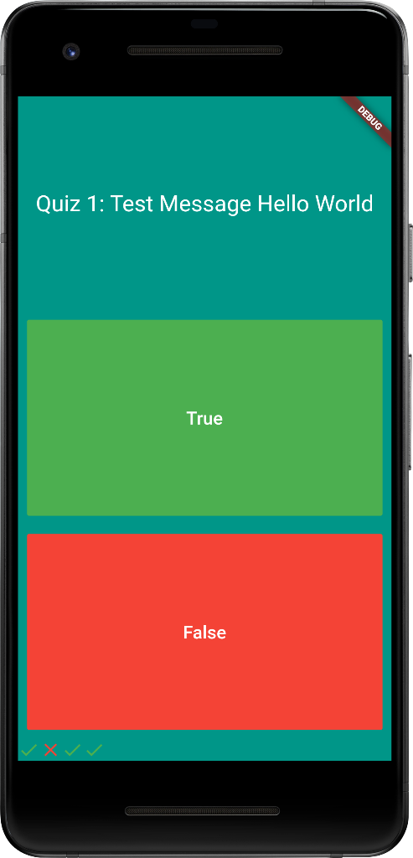
import 'dart:math';
import 'package:flutter/material.dart';
void main() {
return runApp(HafeezMainHomeApp());
}
class HafeezMainHomeApp extends StatefulWidget {
@override
HafeezPageBody createState() => HafeezPageBody();
}
class HafeezPageBody extends State<HafeezMainHomeApp> {
List<Icon> iconsMyList = [
Icon(
Icons.check,
color: Colors.green,
),
Icon(
Icons.close,
color: Colors.red,
),
Icon(
Icons.check,
color: Colors.green,
),
Icon(
Icons.check,
color: Colors.green,
),
];
@override
Widget build(BuildContext context) {
return
MaterialApp(
home: Scaffold(
backgroundColor: Colors.teal,
body: SafeArea(
child: Column(
mainAxisAlignment: MainAxisAlignment.spaceBetween,
crossAxisAlignment: CrossAxisAlignment.stretch,
children: [
Expanded(
child: Padding(
padding: EdgeInsets.all(10.0),
child: Center(
child: Text(
"Quiz 1: Test Message Hello World",
textAlign: TextAlign.center,
style: TextStyle(
fontSize: 25,
color: Colors.white,
),
),
),
),
),
Expanded(
child: Padding(
padding: EdgeInsets.all(15.0),
child: FlatButton(
textColor: Colors.white,
color: Colors.green,
child: Text(
"True",
style: TextStyle(
color: Colors.white,
fontSize: 20,
),
),
onPressed: () {
setState(() {
iconsMyList.add(Icon(Icons.check, color: Colors.green));
});
},
),
),
),
Expanded(
child: Padding(
padding: EdgeInsets.all(15.0),
child: FlatButton(
textColor: Colors.white,
color: Colors.red,
child: Text(
"False",
style: TextStyle(
color: Colors.white,
fontSize: 20,
),
),
onPressed: () {
setState(() {
iconsMyList.add(Icon(Icons.close, color: Colors.red));
});
},
),
),
),
// Row(
// children: [
// Icon(
// Icons.check,
// color: Colors.green,
// ),
// Icon(
// Icons.close,
// color: Colors.red,
// ),
// ]
// ),
Row(children: iconsMyList)
],
),
),
)
);
}
}
Example - 16
UI Design – Show Icons by ArrayList

Slide 24
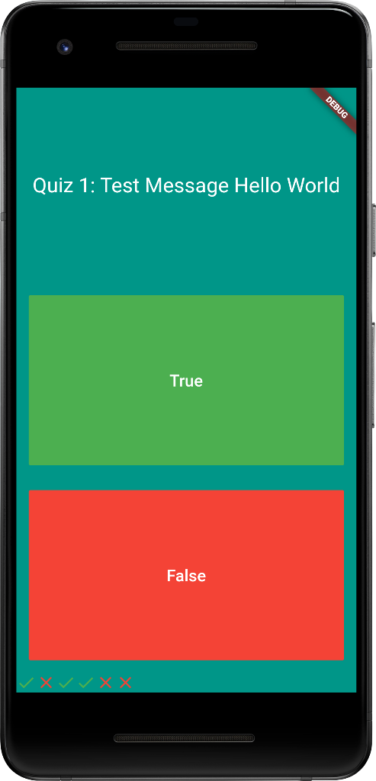
import 'dart:math';
import 'package:flutter/material.dart';
void main() {
return runApp(HafeezMainHomeApp());
}
class HafeezMainHomeApp extends StatefulWidget {
@override
HafeezPageBody createState() => HafeezPageBody();
}
class HafeezPageBody extends State<HafeezMainHomeApp> {
List<Icon> iconsMyList = [];
@override
Widget build(BuildContext context) {
return
MaterialApp(
home: Scaffold(
backgroundColor: Colors.teal,
body: SafeArea(
child: Column(
mainAxisAlignment: MainAxisAlignment.spaceBetween,
crossAxisAlignment: CrossAxisAlignment.stretch,
children: [
Expanded(
child: Padding(
padding: EdgeInsets.all(10.0),
child: Center(
child: Text(
"Quiz 1: Test Message Hello World",
textAlign: TextAlign.center,
style: TextStyle(
fontSize: 25,
color: Colors.white,
),
),
),
),
),
Expanded(
child: Padding(
padding: EdgeInsets.all(15.0),
child: FlatButton(
textColor: Colors.white,
color: Colors.green,
child: Text(
"True",
style: TextStyle(
color: Colors.white,
fontSize: 20,
),
),
onPressed: () {
setState(() {
iconsMyList.add(Icon(Icons.check, color: Colors.green));
});
},
),
),
),
Expanded(
child: Padding(
padding: EdgeInsets.all(15.0),
child: FlatButton(
textColor: Colors.white,
color: Colors.red,
child: Text(
"False",
style: TextStyle(
color: Colors.white,
fontSize: 20,
),
),
onPressed: () {
setState(() {
iconsMyList.add(Icon(Icons.close, color: Colors.red));
});
},
),
),
),
Row(children: iconsMyList),
],
),
),
)
);
}
}
Example - 17
UI Design – ArrayList add dynamic icons

Slide 25
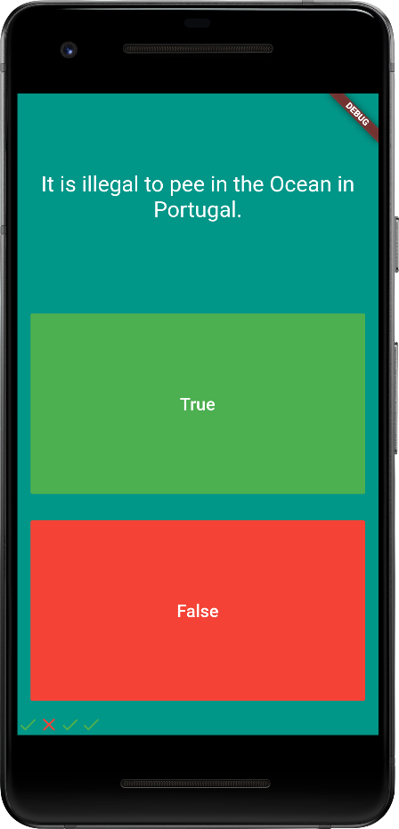
import 'package:flutter/material.dart';
void main() {
return runApp(HafeezMainHomeApp());
}
class HafeezMainHomeApp extends StatefulWidget {
@override
HafeezPageBody createState() => HafeezPageBody();
}
class HafeezPageBody extends State<HafeezMainHomeApp> {
List<Icon> iconsMyList = [];
List <String>myQuestions = [
'Some cats are actually allergic to humans',
'You can lead a cow down stairs but not up stairs.',
'Approximately one quarter of human bones are in the feet.',
'A slug\'s blood is green.',
'It is illegal to pee in the Ocean in Portugal.'
];
List <bool>myQuestionsAnswer = [true, false, true, true, false];
var readQuestionNumber = 0;
@override
Widget build(BuildContext context) {
return
MaterialApp(
home: Scaffold(
backgroundColor: Colors.teal,
body: SafeArea(
child: Column(
mainAxisAlignment: MainAxisAlignment.spaceBetween,
crossAxisAlignment: CrossAxisAlignment.stretch,
children: [
Expanded(
child: Padding(
padding: EdgeInsets.all(10.0),
child: Center(
child: Text(
myQuestions[readQuestionNumber],
textAlign: TextAlign.center,
style: TextStyle(
fontSize: 25,
color: Colors.white,
),
),
),
),
),
Expanded(
child: Padding(
padding: EdgeInsets.all(15.0),
child: FlatButton(
textColor: Colors.white,
color: Colors.green,
child: Text(
"True",
style: TextStyle(
color: Colors.white,
fontSize: 20,
),
),
onPressed: () {
setState(() {
if(myQuestionsAnswer[readQuestionNumber]){
iconsMyList.add(Icon(Icons.check, color: Colors.green));
}
else {
iconsMyList.add(Icon(Icons.close, color: Colors.red));
}
if(myQuestions.length == readQuestionNumber+1){
print('You\'ve reached the end of the quiz.');
readQuestionNumber = 0;
iconsMyList = [];
}
else { readQuestionNumber++; }
});
},
),
),
),
Expanded(
child: Padding(
padding: EdgeInsets.all(15.0),
child: FlatButton(
textColor: Colors.white,
color: Colors.red,
child: Text(
"False",
style: TextStyle(
color: Colors.white,
fontSize: 20,
),
),
onPressed: () {
setState(() {
if(myQuestionsAnswer[readQuestionNumber]){
iconsMyList.add(Icon(Icons.check, color: Colors.green));
}
else {
iconsMyList.add(Icon(Icons.close, color: Colors.red));
}
if(myQuestions.length == readQuestionNumber+1){
print('You\'ve reached the end of the quiz.');
readQuestionNumber = 0;
iconsMyList = [];
}
else { readQuestionNumber++; }
});
},
),
),
),
Row(children: iconsMyList),
],
),
),
)
);
}
}
Example - 18
ArrayList add dynamic (icons) according to correct answer – finish print console message and than restart again quiz

Slide 26
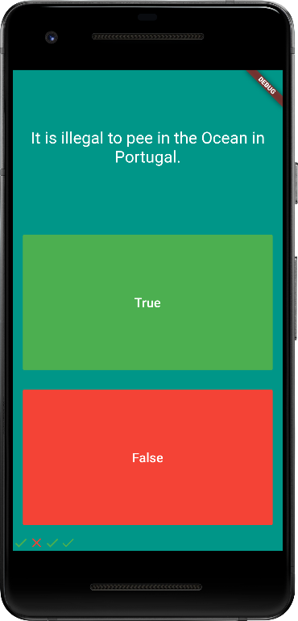
import 'package:flutter/material.dart';
import 'question.dart';
void main() {
return runApp(HafeezMainHomeApp());
}
class HafeezMainHomeApp extends StatefulWidget {
@override
HafeezPageBody createState() => HafeezPageBody();
}
class HafeezPageBody extends State<HafeezMainHomeApp> {
List<Icon> iconsMyList = [];
List<Question> myQuestionsList = [
Question('Some cats are actually allergic to humans', true),
Question('You can lead a cow down stairs but not up stairs.', false),
Question('Approximately one quarter of human bones are in the feet.', true),
Question('A slug\'s blood is green.', true),
Question('It is illegal to pee in the Ocean in Portugal.', true),
];
var readQuestionNumber = 0;
@override
Widget build(BuildContext context) {
return
MaterialApp(
home: Scaffold(
backgroundColor: Colors.teal,
body: SafeArea(
child: Column(
mainAxisAlignment: MainAxisAlignment.spaceBetween,
crossAxisAlignment: CrossAxisAlignment.stretch,
children: [
Expanded(
child: Padding(
padding: EdgeInsets.all(10.0),
child: Center(
child: Text(
myQuestionsList[readQuestionNumber].questionText,
textAlign: TextAlign.center,
style: TextStyle(
fontSize: 25,
color: Colors.white,
),
),
),
),
),
Expanded(
child: Padding(
padding: EdgeInsets.all(15.0),
child: FlatButton(
textColor: Colors.white,
color: Colors.green,
child: Text(
"True",
style: TextStyle(
color: Colors.white,
fontSize: 20,
),
),
onPressed: () {
setState(() {
if(myQuestionsList[readQuestionNumber].questionAnswer){
iconsMyList.add(Icon(Icons.check, color: Colors.green));
}
else {
iconsMyList.add(Icon(Icons.close, color: Colors.red));
}
if(myQuestionsList.length == readQuestionNumber+1){
print('You\'ve reached the end of the quiz.');
readQuestionNumber = 0;
iconsMyList = [];
}
else { readQuestionNumber++; }
});
},
),
),
),
Expanded(
child: Padding(
padding: EdgeInsets.all(15.0),
child: FlatButton(
textColor: Colors.white,
color: Colors.red,
child: Text(
"False",
style: TextStyle(
color: Colors.white,
fontSize: 20,
),
),
onPressed: () {
setState(() {
if(myQuestionsList[readQuestionNumber].questionAnswer){
iconsMyList.add(Icon(Icons.check, color: Colors.green));
}
else {
iconsMyList.add(Icon(Icons.close, color: Colors.red));
}
if(myQuestionsList.length == readQuestionNumber+1){
print('You\'ve reached the end of the quiz.');
readQuestionNumber = 0;
iconsMyList = [];
}
else { readQuestionNumber++; }
});
},
),
),
),
Row(children: iconsMyList),
],
),
),
)
);
}
}
class Question {
String questionText;
bool questionAnswer;
Question(this.questionText, this.questionAnswer);
}
Example - 19
ArrayList Object add dynamic according to correct answer – finish print console message and than restart again quiz

Slide 27
import 'package:flutter/material.dart';
import 'quiz_brain.dart';
QuizBrain quizBrain = QuizBrain();
void main() {
return runApp(HafeezMainHomeApp());
}
class HafeezMainHomeApp extends StatefulWidget {
@override
HafeezPageBody createState() => HafeezPageBody();
}
class HafeezPageBody extends State<HafeezMainHomeApp> {
List<Icon> iconsMyList = [];
@override
Widget build(BuildContext context) {
return
MaterialApp(
home: Scaffold(
backgroundColor: Colors.teal,
body: SafeArea(
child: Column(
mainAxisAlignment: MainAxisAlignment.spaceBetween,
crossAxisAlignment: CrossAxisAlignment.stretch,
children: [
Expanded(
child: Padding(
padding: EdgeInsets.all(10.0),
child: Center(
child: Text(
quizBrain.getQuestionText(),
textAlign: TextAlign.center,
style: TextStyle(
fontSize: 25,
color: Colors.white,
),
),
),
),
),
Expanded(
child: Padding(
padding: EdgeInsets.all(15.0),
child: FlatButton(
textColor: Colors.white,
color: Colors.green,
child: Text(
"True",
style: TextStyle(
color: Colors.white,
fontSize: 20,
),
),
onPressed: () {
setState(() {
if(quizBrain.getCorrectAnswer()){
iconsMyList.add(Icon(Icons.check, color: Colors.green));
}
else {
iconsMyList.add(Icon(Icons.close, color: Colors.red));
}
});
if (quizBrain.isFinished() == true) {
quizBrain.reset();
iconsMyList = [];
}
else { quizBrain.nextQuestion(); }
},
),
),
),
Expanded(
child: Padding(
padding: EdgeInsets.all(15.0),
child: FlatButton(
textColor: Colors.white,
color: Colors.red,
child: Text(
"False",
style: TextStyle(
color: Colors.white,
fontSize: 20,
),
),
onPressed: () {
setState(() {
if(quizBrain.getCorrectAnswer()){
iconsMyList.add(Icon(Icons.check, color: Colors.green));
}
else {
iconsMyList.add(Icon(Icons.close, color: Colors.red));
}
});
if (quizBrain.isFinished() == true) {
quizBrain.reset();
iconsMyList = [];
}
else { quizBrain.nextQuestion(); }
},
),
),
),
Row(children: iconsMyList),
],
),
),
)
);
}
}
class Question {
String questionText;
bool questionAnswer;
Question(this.questionText, this.questionAnswer);
}
import 'question.dart';
class QuizBrain {
var readQuestionNumber = 0;
List<Question> myQuestionsList = [
Question('Some cats are actually allergic to humans', true),
Question('You can lead a cow down stairs but not up stairs.', false),
Question('Approximately one quarter of human bones are in the feet.', true),
Question('A slug\'s blood is green.', true),
Question('It is illegal to pee in the Ocean in Portugal.', true),
];
void nextQuestion() {
if (readQuestionNumber < myQuestionsList.length - 1) {
readQuestionNumber++;
}
}
String getQuestionText() {
return myQuestionsList[readQuestionNumber].questionText;
}
bool getCorrectAnswer() {
return myQuestionsList[readQuestionNumber].questionAnswer;
}
bool isFinished() {
if (readQuestionNumber >= myQuestionsList.length - 1) {
print('Now returning true');
return true;
} else {
return false;
}
}
void reset() {
readQuestionNumber = 0;
}
}
Example - 20
ArrayList Object add dynamic according to correct answer – finish print console message and than restart again quiz

Slide 28
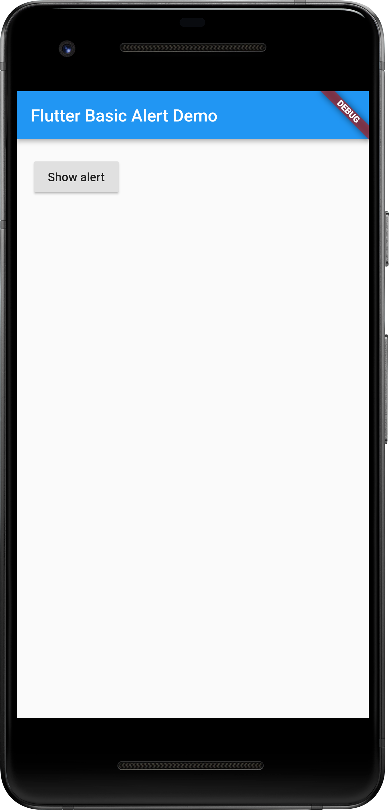
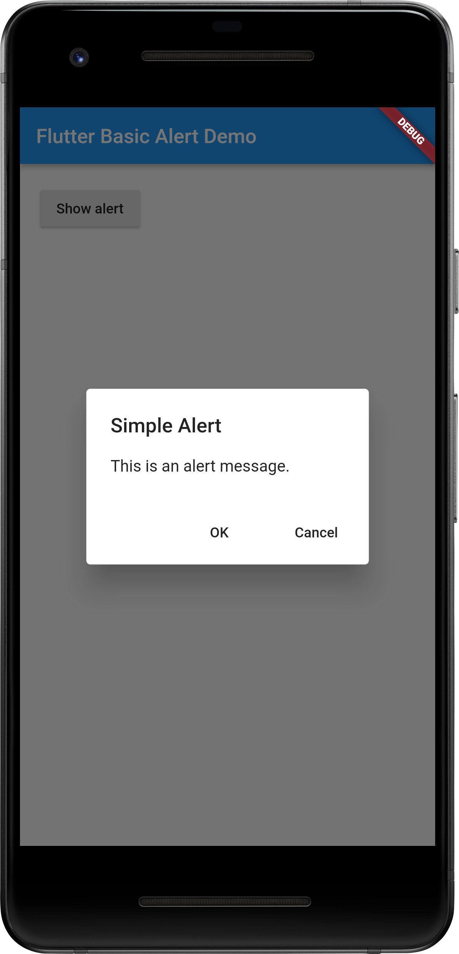
import 'package:flutter/material.dart';
void main() => runApp(MyApp());
class MyApp extends StatelessWidget {
@override
Widget build(BuildContext context) {
return MaterialApp(
home: Scaffold(
appBar: AppBar(
title: Text('Flutter Basic Alert Demo'),
),
body: HomePage(),
),
);
}
}
class HomePage extends StatelessWidget {
@override
Widget build(BuildContext context) {
return Padding(
padding: const EdgeInsets.all(20.0),
child: RaisedButton(
child: Text('Show alert'),
onPressed: () {
showAlertDialog(context);
},
),
);
}
}
showAlertDialog(BuildContext context) {
showDialog(
context: context,
builder: (BuildContext context) {
return AlertDialog(
title: Text("Simple Alert"),
content: Text("This is an alert message."),
actions: [
FlatButton(
child: Text("OK"),
onPressed: () {
print("okay press");
Navigator.of(context).pop();
},
),
FlatButton(
child: Text("Cancel"),
onPressed: () {
print("Cancel press");
Navigator.of(context).pop();
},
),
],
);
},
);
}
Example - 22
Alert Dialog Simple

Slide 29
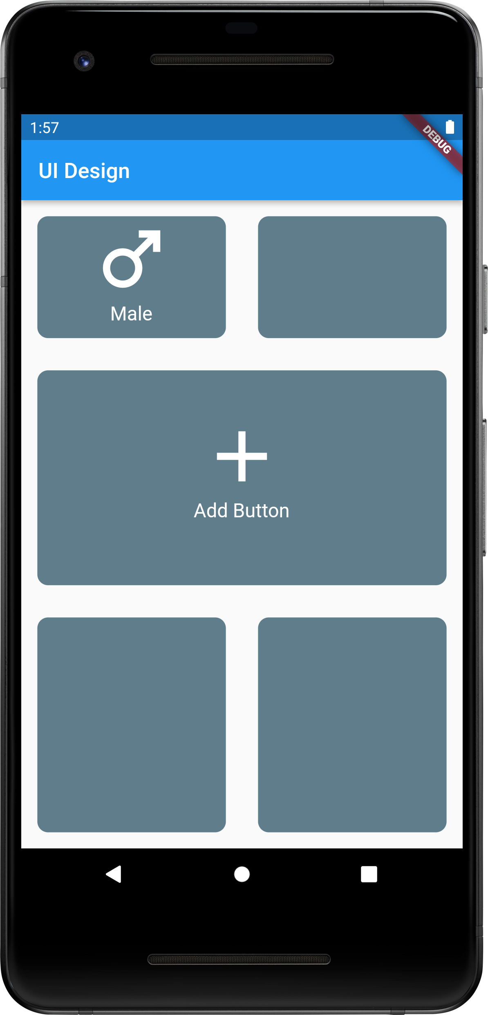
import 'package:flutter/material.dart';
void main() {
runApp(MyApp());
}
class MyApp extends StatelessWidget {
@override
Widget build(BuildContext context) {
return MaterialApp(
home: MyHomePage(),
);
}
}
class MyHomePage extends StatefulWidget {
@override
State<MyHomePage> createState() => _MyHomePageState();
}
class _MyHomePageState extends State<MyHomePage> {
@override
Widget build(BuildContext context) {
return Scaffold(
appBar: AppBar(title: Text("UI Design")),
body: Column(
children: [
Expanded(
child: Row(
children: [
Expanded(
child: Container(
margin: EdgeInsets.all(15),
child: Column(
children: [
Icon(
Icons.male, size: 80,
color: Colors.white,
),
Text(
"Male",
style: TextStyle(
color: Colors.white,
fontSize: 18,
),
)
],
),
decoration: BoxDecoration(
color: Colors.blueGrey,
borderRadius: BorderRadius.circular(10),
),
height: 200,
width: 170,
),
),
Expanded(
child: Container(
margin: EdgeInsets.all(15),
decoration: BoxDecoration(
color: Colors.blueGrey,
borderRadius: BorderRadius.circular(10)
),
height: 200,
width: 170,
),
),
],
),
),
Row(
children: [
Expanded(
child: Container(
margin: EdgeInsets.all(15),
child: Column(
children: [
SizedBox(height:40),
Icon(
Icons.add, size: 80,
color: Colors.white,
),
Text(
"Add Button",
style: TextStyle(
color: Colors.white,
fontSize: 18,
),
)
],
),
decoration: BoxDecoration(
color: Colors.blueGrey,
borderRadius: BorderRadius.circular(10),
),
height: 200,
width: 170,
),
),
],
),
Row(
children: [
Expanded(
child: Container(
margin: EdgeInsets.all(15),
decoration: BoxDecoration(
color: Colors.blueGrey,
borderRadius: BorderRadius.circular(10)
),
height: 200,
width: 170,
),
),
Expanded(
child: Container(
margin: EdgeInsets.all(15),
decoration: BoxDecoration(
color: Colors.blueGrey,
borderRadius: BorderRadius.circular(10)
),
height: 200,
width: 170,
),
),
],
),
],
),
);
}
}
Example - 23
UI Design Cards within Icon and Text

Slide 30
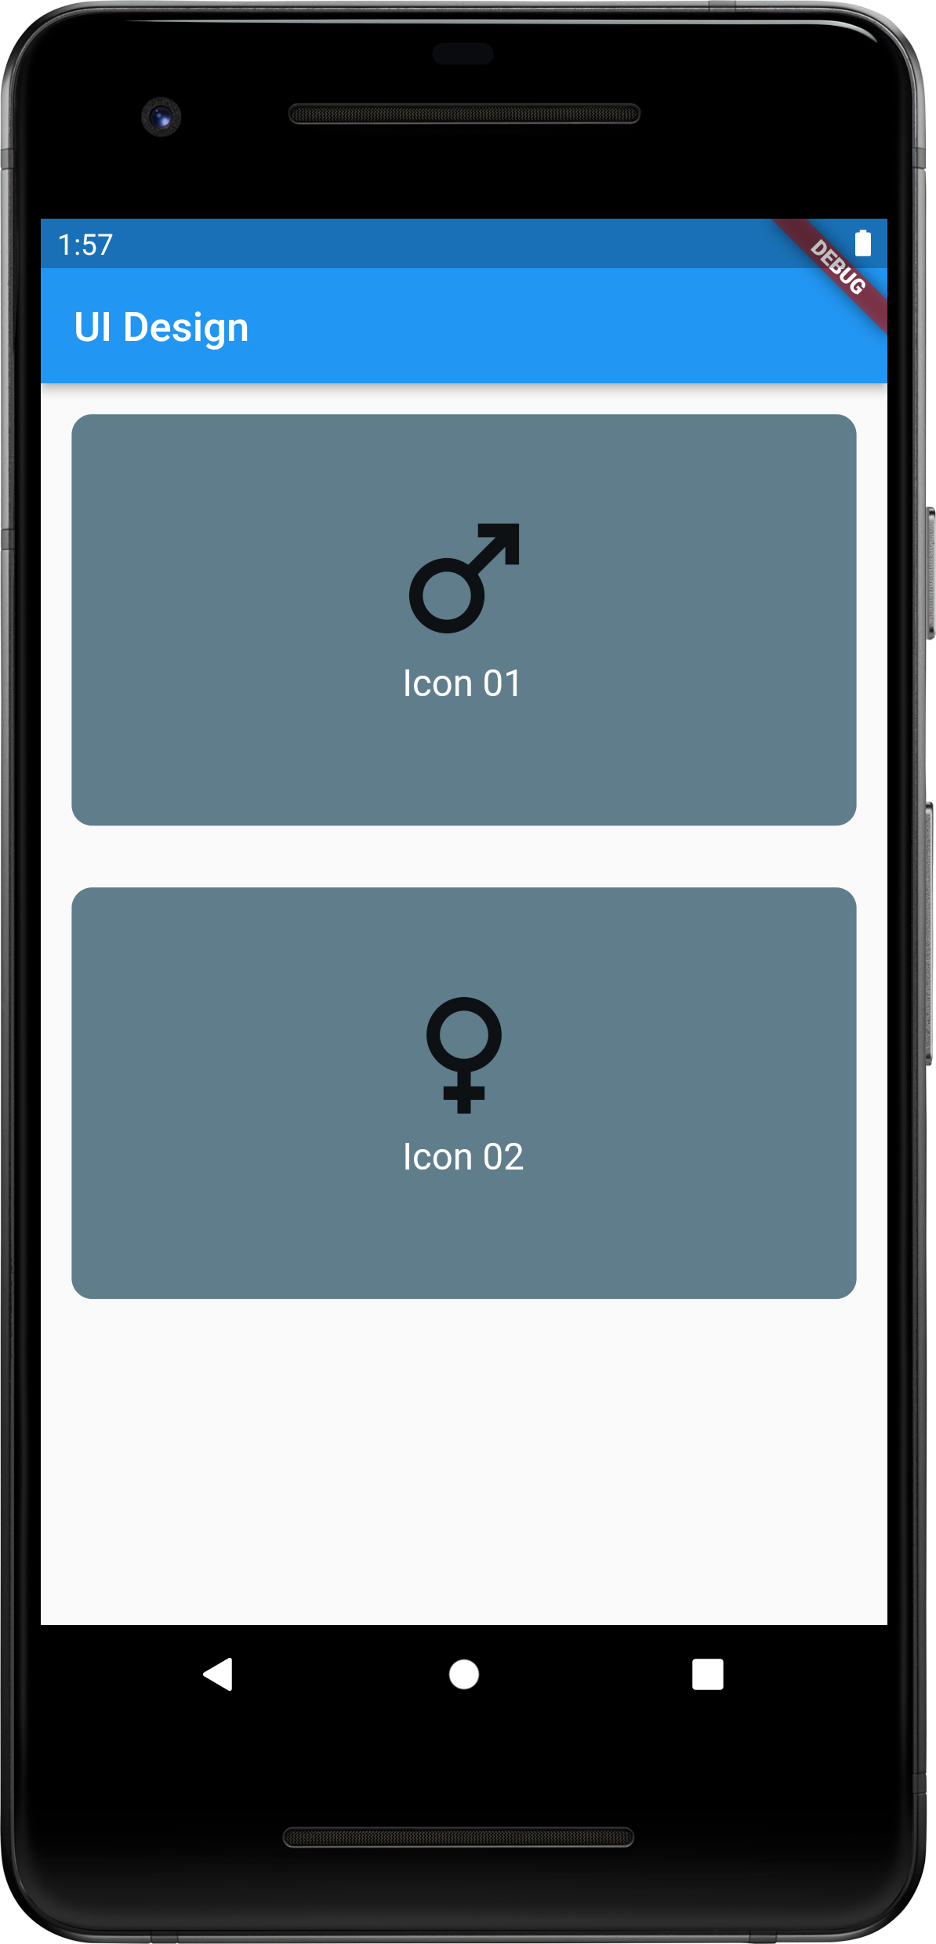
import 'package:flutter/material.dart';
void main() {
runApp(MyApp());
}
class MyApp extends StatelessWidget {
@override
Widget build(BuildContext context) {
return MaterialApp(
home: MyHomePage(),
);
}
}
class MyHomePage extends StatefulWidget {
@override
State<MyHomePage> createState() => _MyHomePageState();
}
class _MyHomePageState extends State<MyHomePage> {
@override
Widget build(BuildContext context) {
return Scaffold(
appBar: AppBar(title: Text("UI Design")),
body: Column(
children: [
MyCard(icon: Icons.male, labelTxt: "Icon 01"),
MyCard(icon: Icons.female, labelTxt: "Icon 02"),
],
),
);
}
}
class MyCard extends StatelessWidget {
MyCard({required this.icon, required this.labelTxt});
final IconData icon;
final String labelTxt;
@override
Widget build(BuildContext context) {
return
Row(
children: [
Expanded(
child: Container(
margin: EdgeInsets.all(15),
child: Column(
children: [
SizedBox(height:40),
Icon(
icon,
size: 80,
),
Text(
labelTxt,
style: TextStyle(
color: Colors.white,
fontSize: 18,
),
)
],
),
decoration: BoxDecoration(
color: Colors.blueGrey,
borderRadius: BorderRadius.circular(10),
),
height: 200,
width: 170,
),
),
],
);
}
}
Example - 24
Create Components – Call Component by Function with Parameters (Icon, Text)

Slide 31
import 'package:flutter/material.dart';
import 'components/my_card.dart';
void main() {
runApp(MyApp());
}
class MyApp extends StatelessWidget {
@override
Widget build(BuildContext context) {
return MaterialApp(
home: MyHomePage(),
);
}
}
class MyHomePage extends StatefulWidget {
@override
State<MyHomePage> createState() => _MyHomePageState();
}
class _MyHomePageState extends State<MyHomePage> {
@override
Widget build(BuildContext context) {
return Scaffold(
appBar: AppBar(title: Text("UI Design")),
body: Column(
children: [
MyCard(icon: Icons.male, labelTxt: "Icon 01"),
MyCard(icon: Icons.female, labelTxt: "Icon 02"),
],
),
);
}
}
import 'package:flutter/cupertino.dart';
import 'package:flutter/material.dart';
class MyCard extends StatelessWidget {
MyCard({required this.icon, required this.labelTxt});
final IconData icon;
final String labelTxt;
@override
Widget build(BuildContext context) {
return
Row(
children: [
Expanded(
child: Container(
margin: EdgeInsets.all(15),
child: Column(
children: [
SizedBox(height:40),
Icon(
icon,
size: 80,
),
Text(
labelTxt,
style: TextStyle(
color: Colors.white,
fontSize: 18,
),
)
],
),
decoration: BoxDecoration(
color: Colors.blueGrey,
borderRadius: BorderRadius.circular(10),
),
height: 200,
width: 170,
),
),
],
);
}
}
Example - 25
Create Components – Call Component by Function with Parameters (Icon, Text) – Separate File

Slide 32
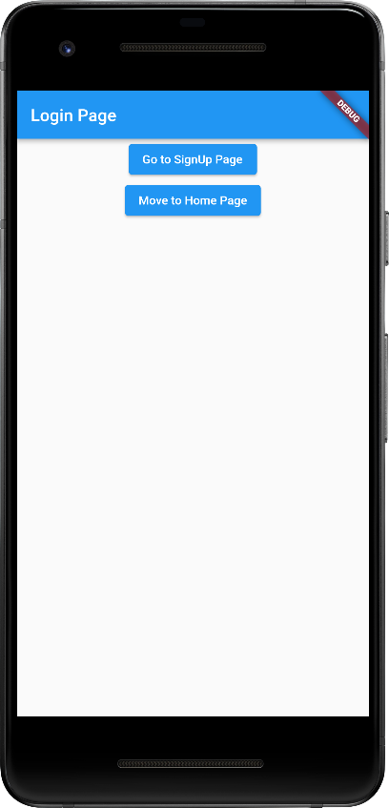
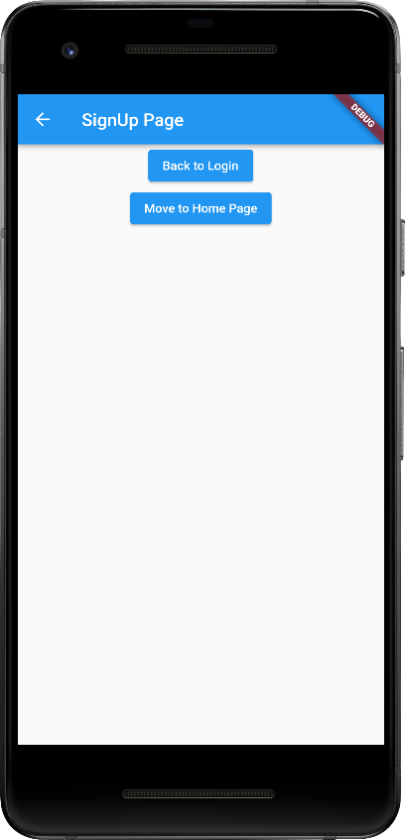
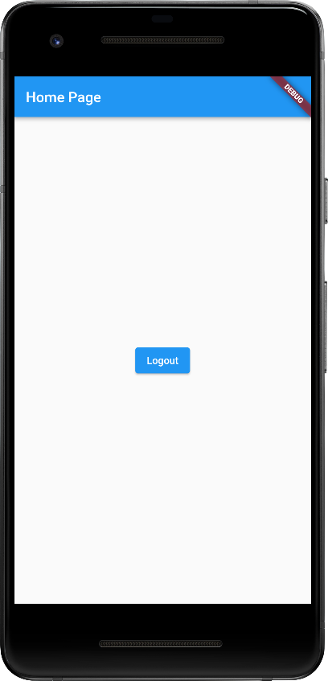
import 'package:flutter/material.dart';
void main() {
runApp(const MaterialApp(
title: 'Navigation Basics',
home: LoginPage(),
));
}
class LoginPage extends StatelessWidget {
const LoginPage({super.key});
@override
Widget build(BuildContext context) {
return Scaffold(
appBar: AppBar(
title: const Text('Login Page'),
),
body: Center(
child: Column(
children: [
ElevatedButton(
child: const Text('Go to SignUp Page'),
onPressed: () {
Navigator.push(
context,
MaterialPageRoute(builder: (context) => const SignupPage()),
);
},
),
ElevatedButton(
onPressed: () {
Navigator.pushAndRemoveUntil(
context,
MaterialPageRoute(
builder: (BuildContext context) => HomePage(),
),
(route) => false,
);
},
child: const Text('Move to Home Page'),
),
],
),
),
);
}
}
class SignupPage extends StatelessWidget {
const SignupPage({super.key});
@override
Widget build(BuildContext context) {
return Scaffold(
appBar: AppBar(
title: const Text('SignUp Page'),
),
body: Center(
child: Column(
children: [
ElevatedButton(
onPressed: () {
Navigator.pop(context);
},
child: const Text('Back to Login'),
),
ElevatedButton(
onPressed: () {
Navigator.pushAndRemoveUntil(
context,
MaterialPageRoute(
builder: (BuildContext context) => HomePage(),
),
(route) => false,
);
},
child: const Text('Move to Home Page'),
),
],
),
),
);
}
}
class HomePage extends StatelessWidget {
const HomePage({super.key});
@override
Widget build(BuildContext context) {
return Scaffold(
appBar: AppBar(
title: const Text('Home Page'),
),
body: Center(
child: ElevatedButton(
onPressed: () {
Navigator.pushAndRemoveUntil(
context,
MaterialPageRoute(
builder: (BuildContext context) => LoginPage(),
),
(route) => false,
);
},
child: const Text('Logout'),
),
),
);
}
}
Page Navigation Simple
Call Activity (or) Page
Login -> Signup -> Home
Example - 26

Slide 33
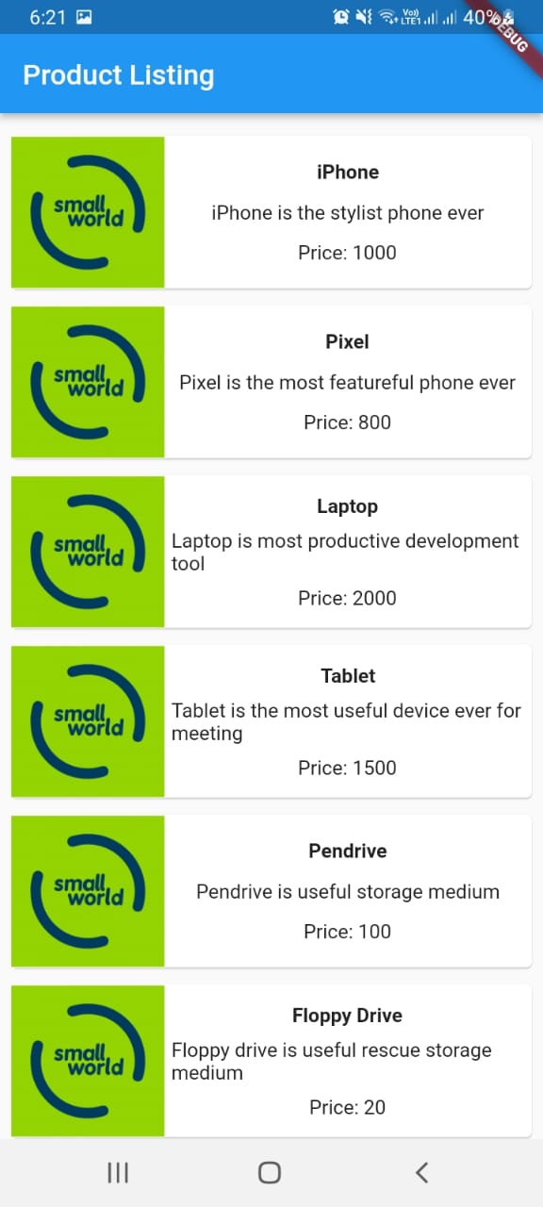
import 'package:flutter/material.dart';
void main() => runApp(MyApp());
class MyApp extends StatelessWidget {
// This widget is the root of your application.
@override
Widget build(BuildContext context) {
return MaterialApp(
title: 'Flutter Demo', theme: ThemeData(
primarySwatch: Colors.blue,
),
home: MyHomePage(title: 'Product layout demo home page'),
);
}
}
class MyHomePage extends StatelessWidget {
MyHomePage({Key? key, required this.title}) : super(key: key);
final String title;
@override
Widget build(BuildContext context) {
return Scaffold(
appBar: AppBar(title: Text("Product Listing")),
body: ListView(
shrinkWrap: true,
padding: const EdgeInsets.fromLTRB(2.0, 10.0, 2.0, 10.0),
children: <Widget>[
ProductBox(
name: "iPhone",
description: "iPhone is the stylist phone ever",
price: 1000,
image: "pic2.png"
),
ProductBox(
name: "Pixel",
description: "Pixel is the most featureful phone ever",
price: 800,
image: "pic2.png"
),
ProductBox(
name: "Laptop",
description: "Laptop is most productive development tool",
price: 2000,
image: "pic2.png"
),
ProductBox(
name: "Tablet",
description: "Tablet is the most useful device ever for meeting",
price: 1500,
image: "pic2.png"
),
ProductBox(
name: "Pendrive",
description: "Pendrive is useful storage medium",
price: 100,
image: "pic2.png"
),
ProductBox(
name: "Floppy Drive",
description: "Floppy drive is useful rescue storage medium",
price: 20,
image: "pic2.png"
),
],
)
);
}
}
class ProductBox extends StatelessWidget {
ProductBox({Key? key, required this.name, required this.description, required this.price, required this.image}) :
super(key: key);
final String name;
final String description;
final int price;
final String image;
Widget build(BuildContext context) {
return Container(
padding: EdgeInsets.all(2),
height: 120,
child: Card(
child: Row(
mainAxisAlignment: MainAxisAlignment.spaceEvenly,
children: <Widget>[
Image.asset("images/" + image),
Expanded(
child: Container(
padding: EdgeInsets.all(5),
child: Column(
mainAxisAlignment: MainAxisAlignment.spaceEvenly,
children: <Widget>[
Text(
this.name, style: TextStyle(
fontWeight: FontWeight.bold
)
),
Text(this.description), Text(
"Price: " + this.price.toString()
),
],
)
)
)
]
)
)
);
}
}

Slide 34
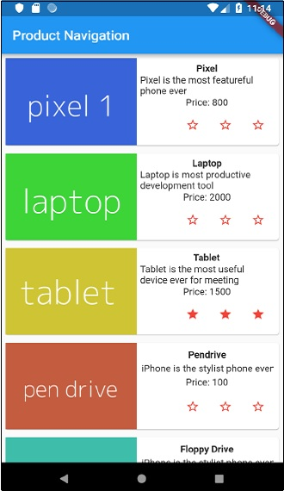
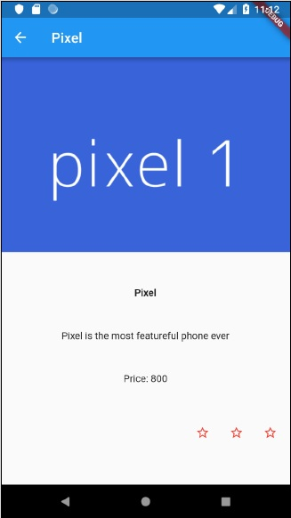
import 'package:flutter/material.dart';
void main() => runApp(MyApp());
class Product {
final String name;
final String description;
final int price;
final String image;
Product(this.name, this.description, this.price, this.image);
static List<Product> getProducts() {
List<Product> items = <Product>[];
items.add(
Product(
"Pixel",
"Pixel is the most featureful phone ever",
800,
"pic2.png"
)
);
items.add(
Product(
"Laptop",
"Laptop is most productive development tool",
2000,
"pic2.png"
)
);
items.add(
Product(
"Tablet",
"Tablet is the most useful device ever for meeting",
1500,
"pic2.png"
)
);
items.add(
Product(
"Pendrive",
"iPhone is the stylist phone ever",
100,
"pic2.png"
)
);
items.add(
Product(
"Floppy Drive",
"iPhone is the stylist phone ever",
20,
"pic2.png"
)
);
items.add(
Product(
"iPhone",
"iPhone is the stylist phone ever",
1000,
"pic2.png"
)
);
return items;
}
}
class MyApp extends StatelessWidget {
// This widget is the root of your application.
@override
Widget build(BuildContext context) {
return MaterialApp(
title: 'Flutter Demo',
theme: ThemeData(
primarySwatch: Colors.blue,
),
home: MyHomePage(title: 'Product Navigation demo home page'),
);
}
}
class MyHomePage extends StatelessWidget {
MyHomePage({Key? key, required this.title}) : super(key: key);
final String title;
final items = Product.getProducts();
@override
Widget build(BuildContext context) {
return Scaffold(
appBar: AppBar(title: Text("Product Navigation")),
body: ListView.builder(
itemCount: items.length,
itemBuilder: (context, index) {
return GestureDetector(
child: ProductBox(item: items[index]),
onTap: () {
Navigator.push(
context,
MaterialPageRoute(
builder: (context) => ProductPage(item: items[index]),
),
);
},
);
},
)
);
}
}
class ProductPage extends StatelessWidget {
ProductPage({Key? key, required this.item}) : super(key: key);
final Product item;
@override
Widget build(BuildContext context) {
return Scaffold(
appBar: AppBar(
title: Text(this.item.name),
),
body: Center(
child: Container(
padding: EdgeInsets.all(0),
child: Column(
mainAxisAlignment: MainAxisAlignment.start,
crossAxisAlignment: CrossAxisAlignment.start,
children: <Widget>[
Image.asset("images/" + this.item.image),
Expanded(
child: Container(
padding: EdgeInsets.all(5),
child: Column(
mainAxisAlignment: MainAxisAlignment.spaceEvenly,
children: <Widget>[
Text(this.item.name, style: TextStyle(fontWeight: FontWeight.bold)),
Text(this.item.description),
Text("Price: " + this.item.price.toString()),
RatingBox(),
],
)
)
)
]
),
),
),
);
}
}
class RatingBox extends StatefulWidget {
@override
_RatingBoxState createState() => _RatingBoxState();
}
class _RatingBoxState extends State<RatingBox> {
int _rating = 0;
void _setRatingAsOne() {
setState(() {
_rating = 1;
});
}
void _setRatingAsTwo() {
setState(() {
_rating = 2;
});
}
void _setRatingAsThree() {
setState(() {
_rating = 3;
});
}
Widget build(BuildContext context) {
double _size = 20;
print(_rating);
return Row(
mainAxisAlignment: MainAxisAlignment.end,
crossAxisAlignment: CrossAxisAlignment.end,
mainAxisSize: MainAxisSize.max,
children: <Widget>[
Container(
padding: EdgeInsets.all(0),
child: IconButton(
icon: (
_rating >= 1 ? Icon(
Icons.star,
size: _size,
)
: Icon(
Icons.star_border,
size: _size,
)
),
color: Colors.red[500],
onPressed: _setRatingAsOne,
iconSize: _size,
),
),
Container(
padding: EdgeInsets.all(0),
child: IconButton(
icon: (
_rating >= 2 ?
Icon(
Icons.star,
size: _size,
)
: Icon(
Icons.star_border,
size: _size,
)
),
color: Colors.red[500],
onPressed: _setRatingAsTwo,
iconSize: _size,
),
),
Container(
padding: EdgeInsets.all(0),
child: IconButton(
icon: (
_rating >= 3 ?
Icon(
Icons.star,
size: _size,
)
: Icon(
Icons.star_border,
size: _size,
)
),
color: Colors.red[500],
onPressed: _setRatingAsThree,
iconSize: _size,
),
),
],
);
}
}
class ProductBox extends StatelessWidget {
ProductBox({Key? key, required this.item}) : super(key: key);
final Product item;
Widget build(BuildContext context) {
return Container(
padding: EdgeInsets.all(2),
height: 140,
child: Card(
child: Row(
mainAxisAlignment: MainAxisAlignment.spaceEvenly,
children: <Widget>[
Image.asset("images/" + this.item.image),
Expanded(
child: Container(
padding: EdgeInsets.all(5),
child: Column(
mainAxisAlignment: MainAxisAlignment.spaceEvenly,
children: <Widget>[
Text(this.item.name, style: TextStyle(fontWeight: FontWeight.bold)), Text(this.item.description),
Text("Price: " + this.item.price.toString()),
RatingBox(),
],
)
)
)
]
),
)
);
}
}

